Slide 1
Atmosphere Environment (Air and water) Energy (Chemical and Solar)

Slide 2
Terms and Definitions
Atmosphere – The mixture of gases, water droplets, and solid particles above the earth’s surface

Slide 3
Terms and Definitions
Atmosphere – The mixture of gases, water droplets, and solid particles above the earth’s surface
Weather – Short-term atmospheric phenomena lasting from hours up to about a week (e.g. thunderstorms, hurricanes, periods of high winds, drizzle)

Slide 4
Terms and Definitions
Atmosphere – The mixture of gases, water droplets, and solid particles above the earth’s surface
Weather – Short-term atmospheric phenomena lasting from hours up to about a week (e.g. thunderstorms, hurricanes, periods of high winds, drizzle)
Climate – Long-term atmospheric conditions lasting from weeks to years (e.g. average yearly Lubbock precipitation, global warming)

Slide 5
Terms and Definitions
Atmosphere – The mixture of gases, water droplets, and solid particles above the earth’s surface
Weather – Short-term atmospheric phenomena lasting from hours up to about a week (e.g. thunderstorms, hurricanes, periods of high winds, drizzle)
Climate – Long-term atmospheric conditions lasting from weeks to years (e.g. average yearly Lubbock precipitation, global warming)
Meteorology – The study of weather

Slide 6
Terms and Definitions
Atmosphere – The mixture of gases, water droplets, and solid particles above the earth’s surface
Weather – Short-term atmospheric phenomena lasting from hours up to about a week (e.g. thunderstorms, hurricanes, periods of high winds, drizzle)
Climate – Long-term atmospheric conditions lasting from weeks to years (e.g. average yearly Lubbock precipitation, global warming)
Meteorology – The study of weather
Climatology – The study of climate

Slide 7
Thickness of the Atmosphere
How high is the atmosphere?
No defined top

Slide 8
Thickness of the Atmosphere
How high is the atmosphere?
No defined top
99.99997% of atmosphere is below 100 km (60 mi)

Slide 9
Thickness of the Atmosphere
How high is the atmosphere?
No defined top
99.99997% of atmosphere is below 100 km (60 mi)
Weather occurs in lowest 11 km (7 mi)

Slide 10
The Evolution of the Atmosphere
Earth’s early atmosphere contained mostly hydrogen and helium

Slide 11
The Evolution of the Atmosphere
Earth’s early atmosphere contained mostly hydrogen and helium
Two hypotheses exist that explain the dispersion of this early atmosphere
The gases escaped to space by overcoming gravity with large enough escape velocities
Collisions between earth and other large bodies launched the early atmosphere to space

Slide 12
The Evolution of the Atmosphere
Earth’s early atmosphere contained mostly hydrogen and helium
Two hypotheses exist that explain the dispersion of this early atmosphere
The gases escaped to space by overcoming gravity with large enough escape velocities
Collisions between earth and other large bodies launched the early atmosphere to space
A modern atmosphere began to form through outgassing by volcanic eruptions, and possibly through collisions of comets with earth (Both supplying mostly carbon dioxide and water vapor)

Slide 13
The Evolution of the Atmosphere
Water vapor condensed and precipitated to form oceans

Slide 14
The Evolution of the Atmosphere
Water vapor condensed and precipitated to form oceans
Carbon dioxide lost to oceans

Slide 15
The Evolution of the Atmosphere
Water vapor condensed and precipitated to form oceans
Carbon dioxide lost to oceans
Oxygen released first through primitive oceanic bacteria, later through plants (protected by ozone layer)

Slide 16
The Evolution of the Atmosphere
Water vapor condensed and precipitated to form oceans
Carbon dioxide lost to oceans
Oxygen released first through primitive oceanic bacteria, later through plants (protected by ozone layer)
Plants further reduced carbon dioxide

Slide 17
The Evolution of the Atmosphere
Water vapor condensed and precipitated to form oceans
Carbon dioxide lost to oceans
Oxygen released first through primitive oceanic bacteria, later through plants (protected by ozone layer)
Plants further reduced carbon dioxide
Nitrogen slowly increased over long periods of time through outgassing

Slide 18
Composition of the Modern Atmosphere
The atmosphere today contains:
Gases (permanent and variable)
Water droplets (clouds and precipitation)
Microscopic solid particles (aerosols)

Slide 19
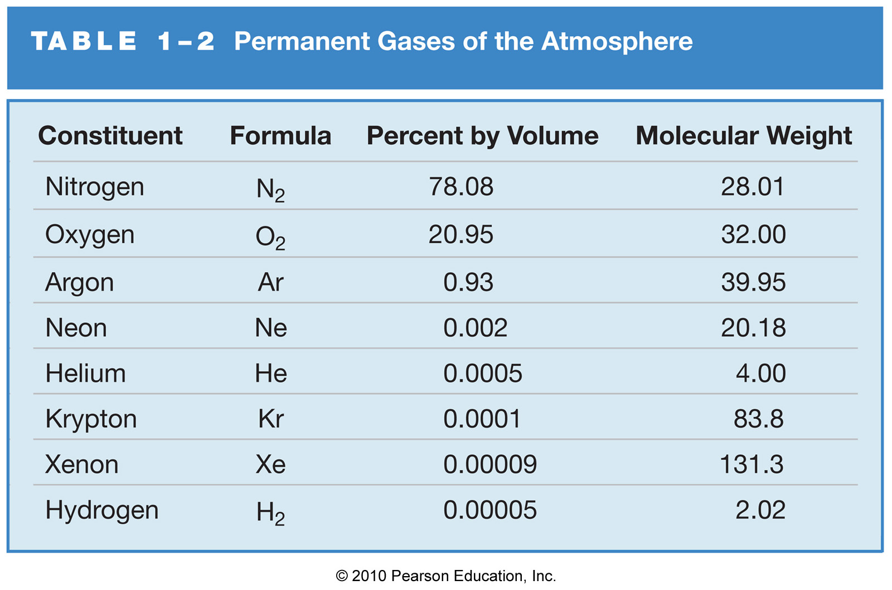
The Permanent Gases
Permanent gases form a constant proportion of the atmosphere, and have long residence times (thousands to millions of years)

Slide 20
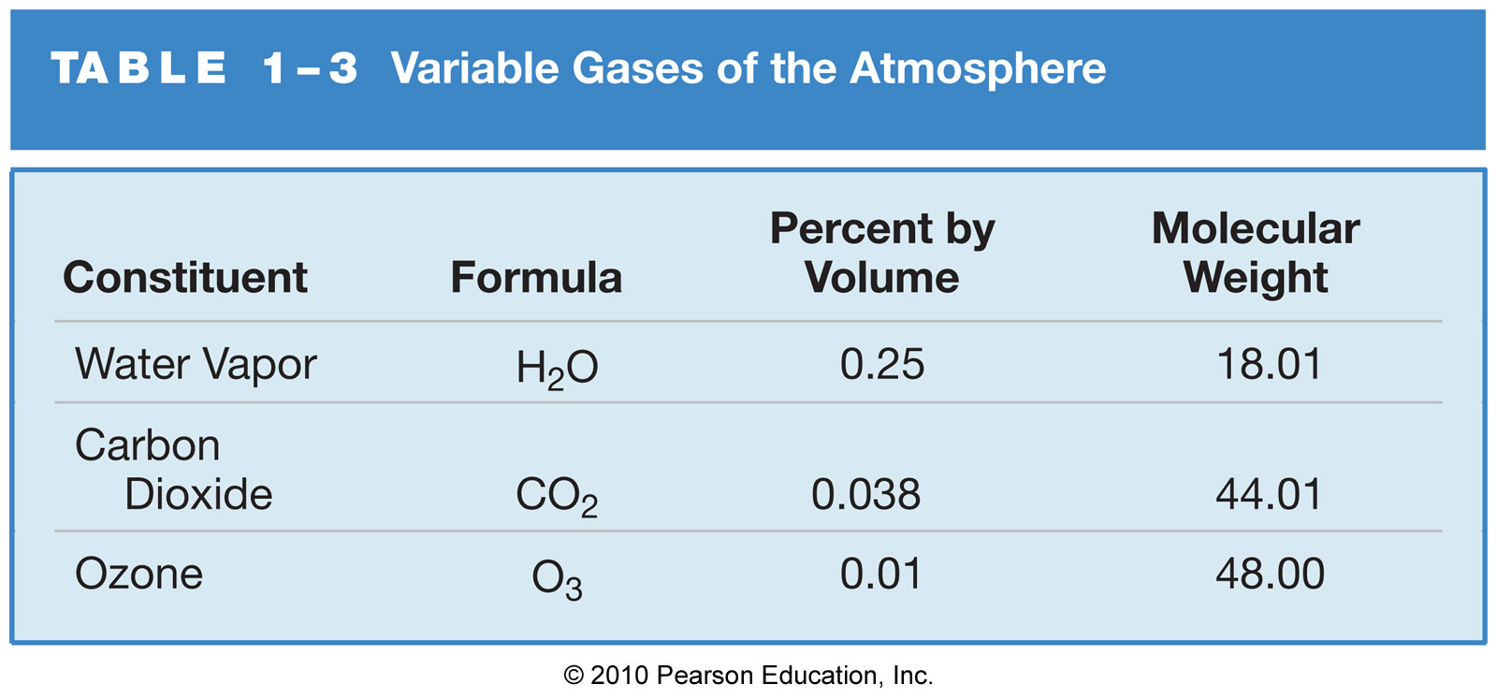
The Variable Gases
Variable gases vary in atmospheric concentration in both time and space

Slide 21
Water Vapor
Water vapor (H₂O) – Extremely important variable gas with short residence time (~10 days)

Slide 22
Water Vapor
Water vapor (H₂O) – Extremely important variable gas with short residence time (~10 days)
Water vapor is the invisible gaseous phase of water (you can only see liquid water droplets!)

Slide 23
The Atmosphere
Layers of the Atmosphere
Air Pressure
Transfer of Heat Energy
Earth-Atmosphere Energy Balance
Hydrologic Cycle

Slide 24
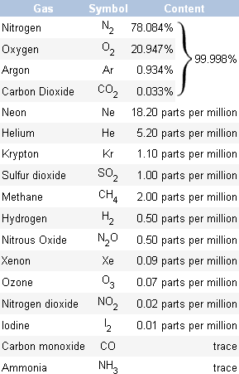
The gases that makeup the Atmosphere
Notes:
The atmosphere is a cloud of gas and suspended solids extending from the Earth's surface out many thousands of miles, becoming increasingly thinner with distance but always held by the Earth's gravitational pull. The atmosphere is made up of layers surrounding the earth that holds the air we breath, protects us from outer space, and holds moisture (clouds), gases, and tiny particles. In short, the atmosphere is the protective bubble we live in. This protective bubble consists of several gases (below) with the top four making up 99.998% of all gases. By far, the most common, nitrogen, dilutes oxygen and prevents rapid burning at the earth's surface. Living things need it to make proteins. Oxygen is used by all living things and is essential for respiration. It is also necessary for combustion or burning. Argon is used in light bulbs. Plants use carbon dioxide to make oxygen. Carbon dioxide also acts as a blanket and prevents the escape of heat into outer space.

Slide 25
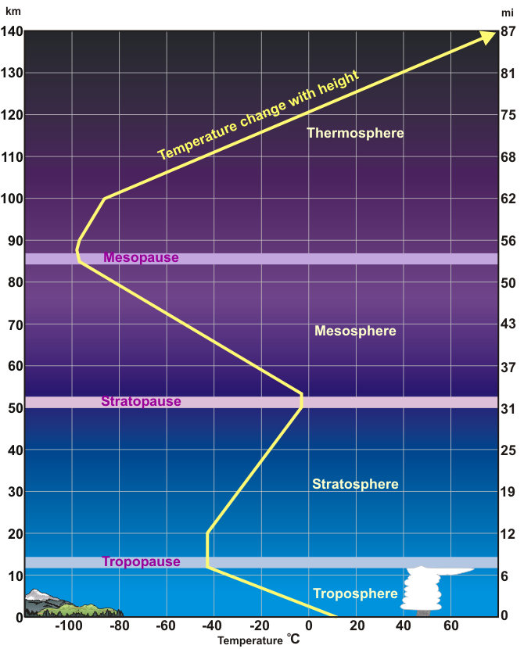
Layers of the Atmosphere
Troposphere
Lowest Layer
This is where we live
8 to 12 miles in height
Weather occurs
Temp decreases with height
Stratosphere - Second lowest layer - Temp increases with height - Ozone (03) layer - Absorbs most of the damaging ultraviolet sunlight (UV-B)
Mesosphere - From ~30 to 53 miles up
- Temp decreases - Majority of meteors burn up
Thermosphere - Upper atmosphere 53 to ~430 miles up
- Very few molecules
Still would feel cold
Ozone Layer
Notes:
The envelope of gas surrounding the Earth changes from the ground up. Five distinct layers have been identified using
thermal characteristics (temperature changes), chemical composition, movement, and density. Each of the layers are bounded by "pauses" where the maximum changes in thermal characteristics, chemical composition, movement, and density occur. Troposphere
The troposphere begins at the Earth's surface and extends up to 4-12 miles (6-20 km) high. This is where we live. As the gases in this layer decrease with height, the air become thinner. Therefore, the temperature in the troposphere also decreases with height. As you climb higher, the temperature drops from about 62°F (17°C) to -60°F (-51°C). Almost all weather occurs in this region. The height of the troposphere varies from the equator to the poles. At the equator it is around 11-12 miles (18-20 km) high, at 50°N and 50°S, 5½ miles and at the poles just under four miles high. The transition boundary between the troposphere and the layer above is called the tropopause. Both the tropopause and the troposphere are known as the lower atmosphere. Stratosphere
The Stratosphere extends from the tropopause up to 31 miles above the Earth's surface. This layer holds 19 percent of the atmosphere's gases but very little water vapor. Temperature increases with height as radiation is increasingly absorbed by oxygen molecules which leads to the formation of Ozone. The temperature rises from an average -76°F (-60°C) at tropopause to a maximum of about 5°F (-15°C) at the stratopause due to this absorption of ultraviolet radiation. The increasing temperature also makes it a calm layer with movements of the gases slow. The regions of the stratosphere and the mesosphere, along with the stratopause and mesopause, are called the middle atmosphere by scientists. The transition boundary which separates the stratosphere from the mesosphere is called the stratopause. Mesosphere
The mesosphere extends from the stratopause to about 53 miles (85 km) above the earth. The gases, including the oxygen molecules, continue to become thinner and thinner with height. As such, the effect of the warming by ultraviolet radiation also becomes less and less leading to a decrease in temperature with height. On average, temperature decreases from about 5°F (-15°C) to as low as -184°F (-120°C) at the mesopause. However, the gases in the mesosphere are thick enough to slow down meteorites hurtling into the atmosphere, where they burn up, leaving fiery trails in the night sky. Thermosphere
The Thermosphere extends from the mesopause to 430 miles (690 km) above the earth. This layer is known as the upper atmosphere. The gases of the thermosphere are increasingly thinner than in the mesosphere. As such, only the higher energy ultraviolet and x-ray radiation from the sun is absorbed. But because of this absorption, the temperature increases with height and can reach as high as 3,600°F (2000°C) near the top of this layer. However, despite the high temperature, this layer of the atmosphere would still feel very cold to our skin because of the extremely thin air. The total amount of energy from the very few molecules in this layer is not sufficient enough to heat our skin.

Slide 26
The envelope of gas surrounding the Earth changes from the ground up. Five distinct layers have been identified using thermal characteristics (temperature changes), chemical composition, movement, and density. Each of the layers are bounded by "pauses" where the maximum changes in thermal characteristics, chemical composition, movement, and density occur. Troposphere
The troposphere begins at the Earth's surface and extends up to 4-12 miles (6-20 km) high. This is where we live. As the gases in this layer decrease with height, the air become thinner. Therefore, the temperature in the troposphere also decreases with height. As you climb higher, the temperature drops from about 62°F (17°C) to -60°F (-51°C). Almost all weather occurs in this region.
The height of the troposphere varies from the equator to the poles. At the equator it is around 11-12 miles (18-20 km) high, at 50°N and 50°S, 5½ miles and at the poles just under four miles high. The transition boundary between the troposphere and the layer above is called the tropopause. Both the tropopause and the troposphere are known as the lower atmosphere. Stratosphere
The Stratosphere extends from the tropopause up to 31 miles above the Earth's surface. This layer holds 19 percent of the atmosphere's gases but very little water vapor. Temperature increases with height as radiation is increasingly absorbed by oxygen molecules which leads to the formation of Ozone. The temperature rises from an average -76°F (-60°C) at tropopause to a maximum of about 5°F (-15°C) at the stratopause due to this absorption of ultraviolet radiation. The increasing temperature also makes it a calm layer with movements of the gases slow. The regions of the stratosphere and the mesosphere, along with the stratopause and mesopause, are called the middle atmosphere by scientists. The transition boundary which separates the stratosphere from the mesosphere is called the stratopause.

Slide 27
Mesosphere
The mesosphere extends from the stratopause to about 53 miles (85 km) above the earth. The gases, including the oxygen molecules, continue to become thinner and thinner with height. As such, the effect of the warming by ultraviolet radiation also becomes less and less leading to a decrease in temperature with height. On average, temperature decreases from about 5°F (-15°C) to as low as -184°F (-120°C) at the mesopause. However, the gases in the mesosphere are thick enough to slow down meteorites hurtling into the atmosphere, where they burn up, leaving fiery trails in the night sky. Thermosphere
The Thermosphere extends from the mesopause to 430 miles (690 km) above the earth. This layer is known as the upper atmosphere. The gases of the thermosphere are increasingly thinner than in the mesosphere. As such, only the higher energy ultraviolet and x-ray radiation from the sun is absorbed. But because of this absorption, the temperature increases with height and can reach as high as 3,600°F (2000°C) near the top of this layer. However, despite the high temperature, this layer of the atmosphere would still feel very cold to our skin because of the extremely thin air. The total amount of energy from the very few molecules in this layer is not sufficient enough to heat our skin.

Slide 28
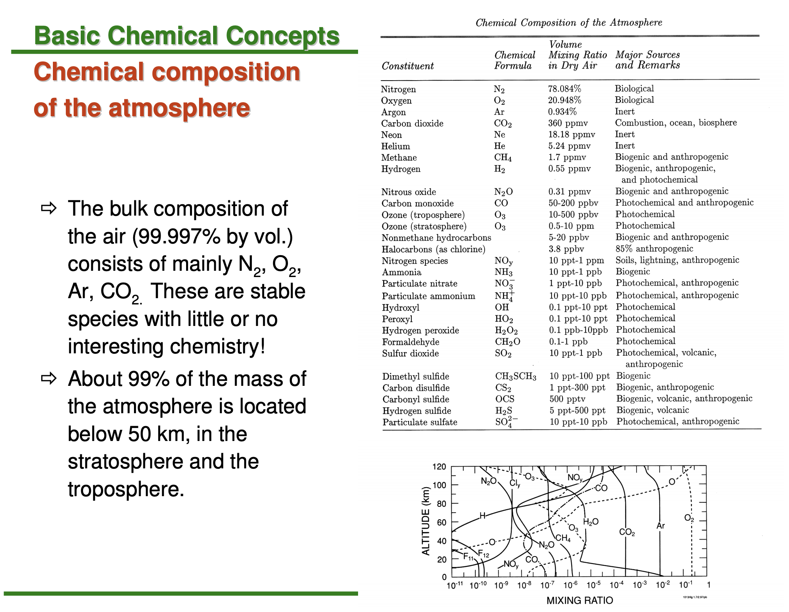
Atmospheric Composition
Notes:
all concentrations are in dry air (except, obviously, for H₂O)

Slide 29
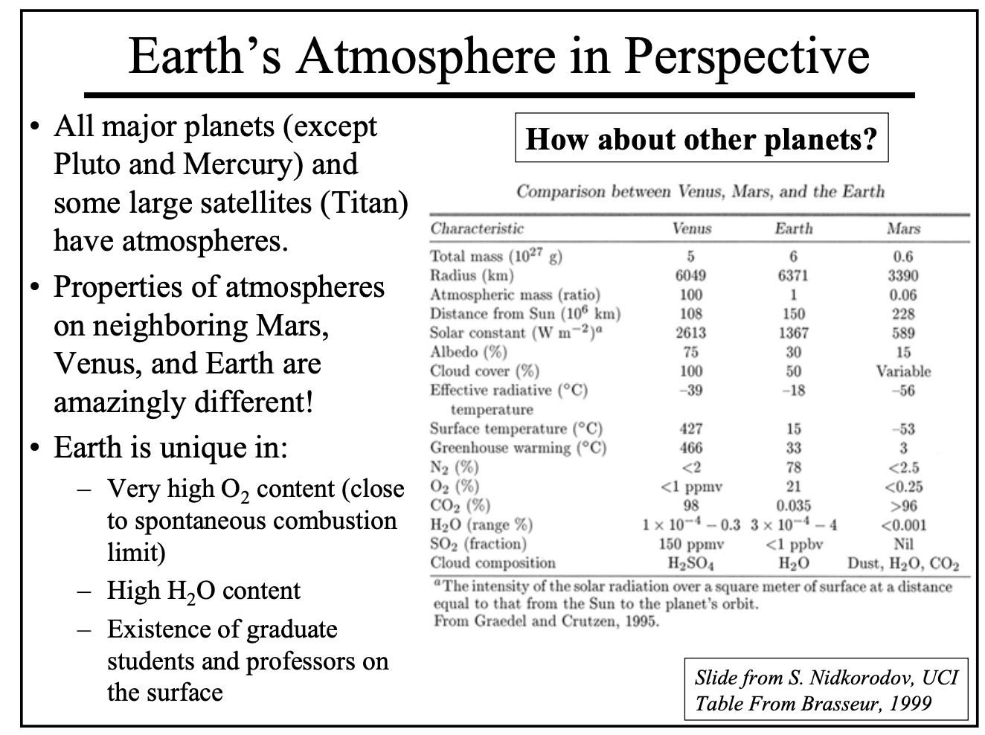

Slide 30
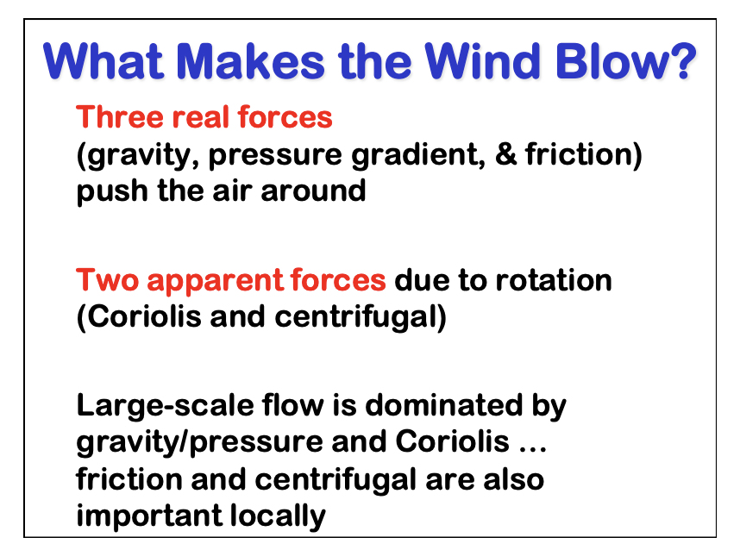
Large-scale movement of air in the atmosphere is driven by horizontal pressure gradients originating from differential heating of the Earth's surface.
As air moves from high to low pressure on the surface of the rotating Earth, it is deflected by the Coriolis force. We begin with an explanation of the Coriolis force and then go on to examine the balance between the pressure-gradient and Coriolis forces.

Slide 31
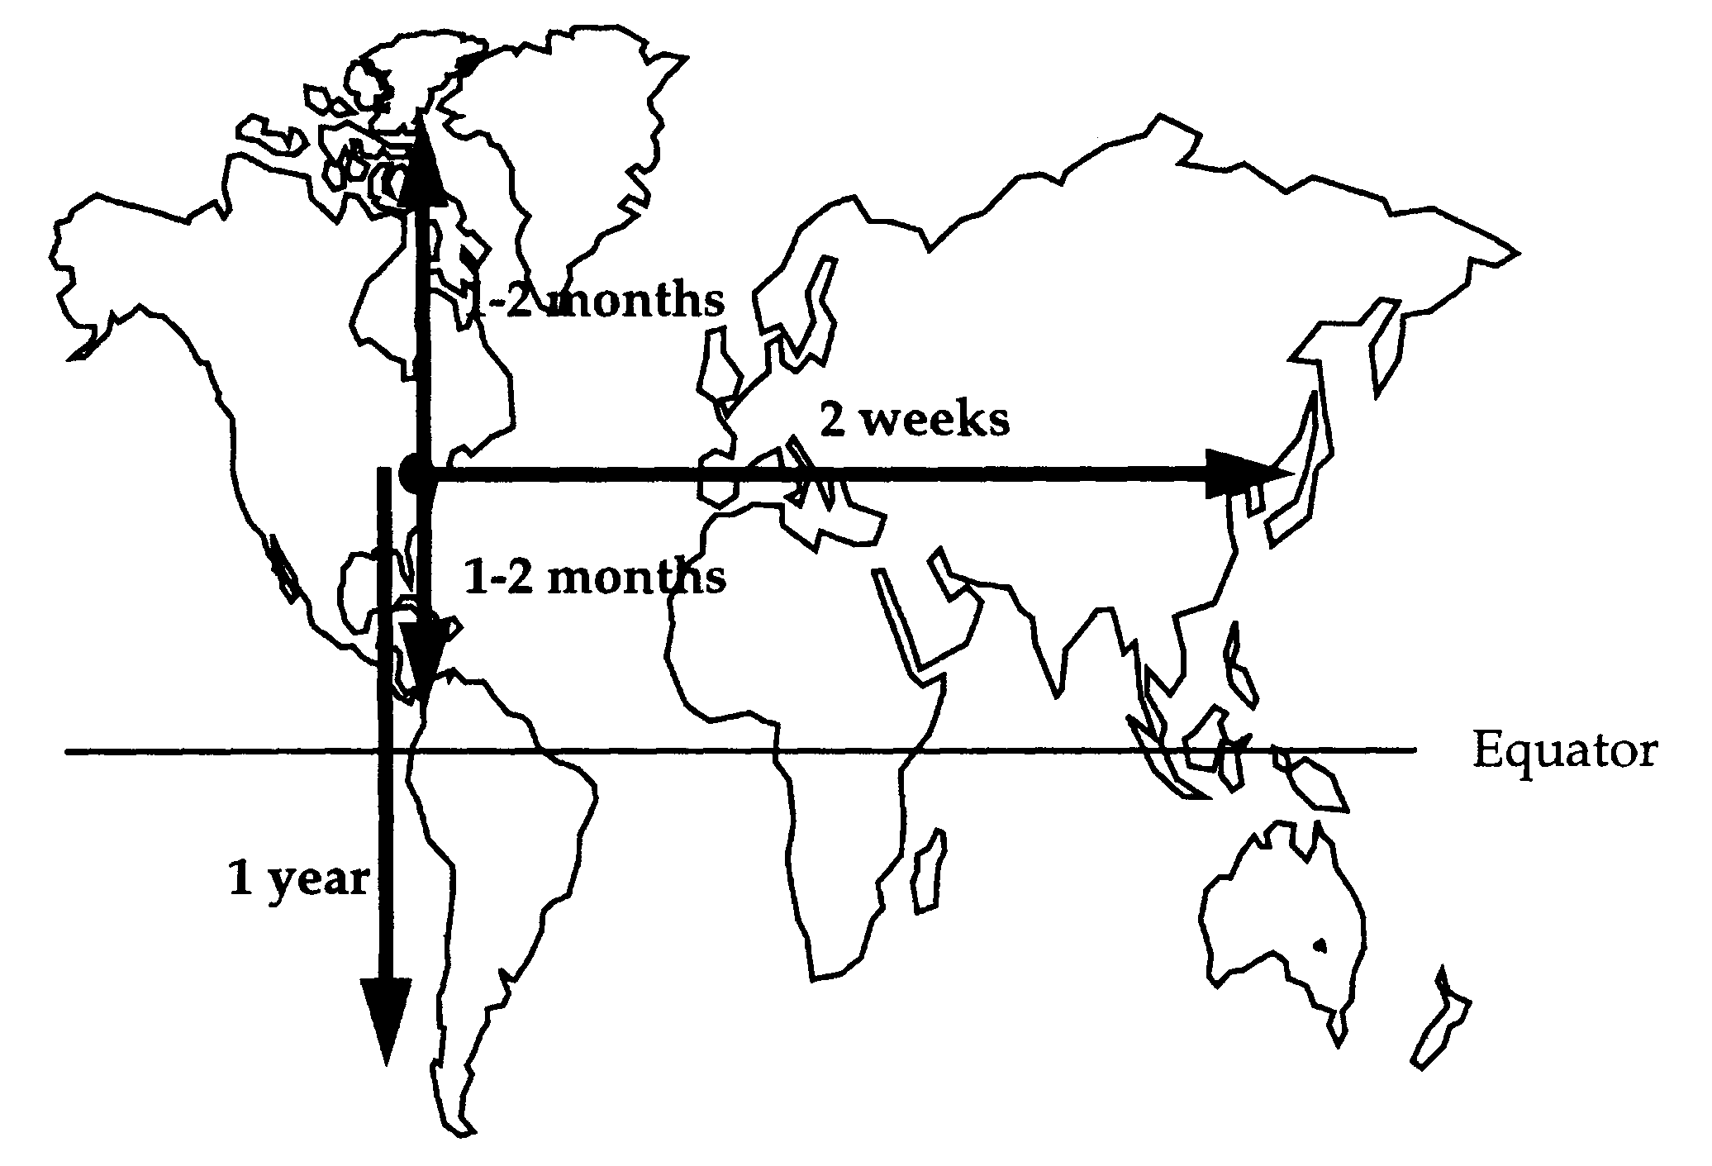
Time Scales of Horizontal Mixing
Notes:
Horizontal mixing is driven by pressure differences due to uneven heating by the Sun. MIxing along latitutdes (zonal mixing) is very fast; mixing along longitudes within a hemisphere (meridional mixing) is also pretty fast. Interhemispheric exchange is much slower.

Slide 32
Horizontal mixing is driven by pressure differences due to uneven heating by the Sun.
Mixing along latitutdes (zonal mixing) is very fast;
mixing along longitudes within a hemisphere (meridional mixing) is also
pretty fast. Interhemispheric exchange is much slower.

Slide 33
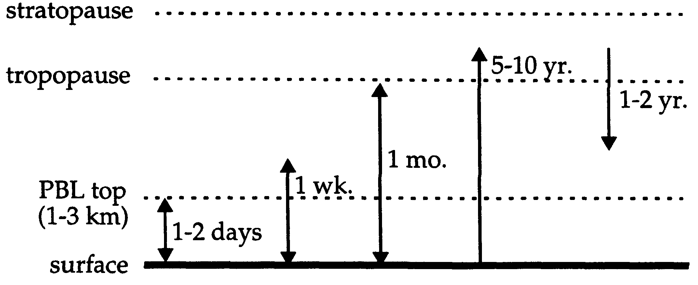
Time Scales of Vertical Mixing
Vertical mixing is due mostly to adiabatic heating/cooling of air parcels, as well as turbulent mixing from horizontal winds.

Slide 34
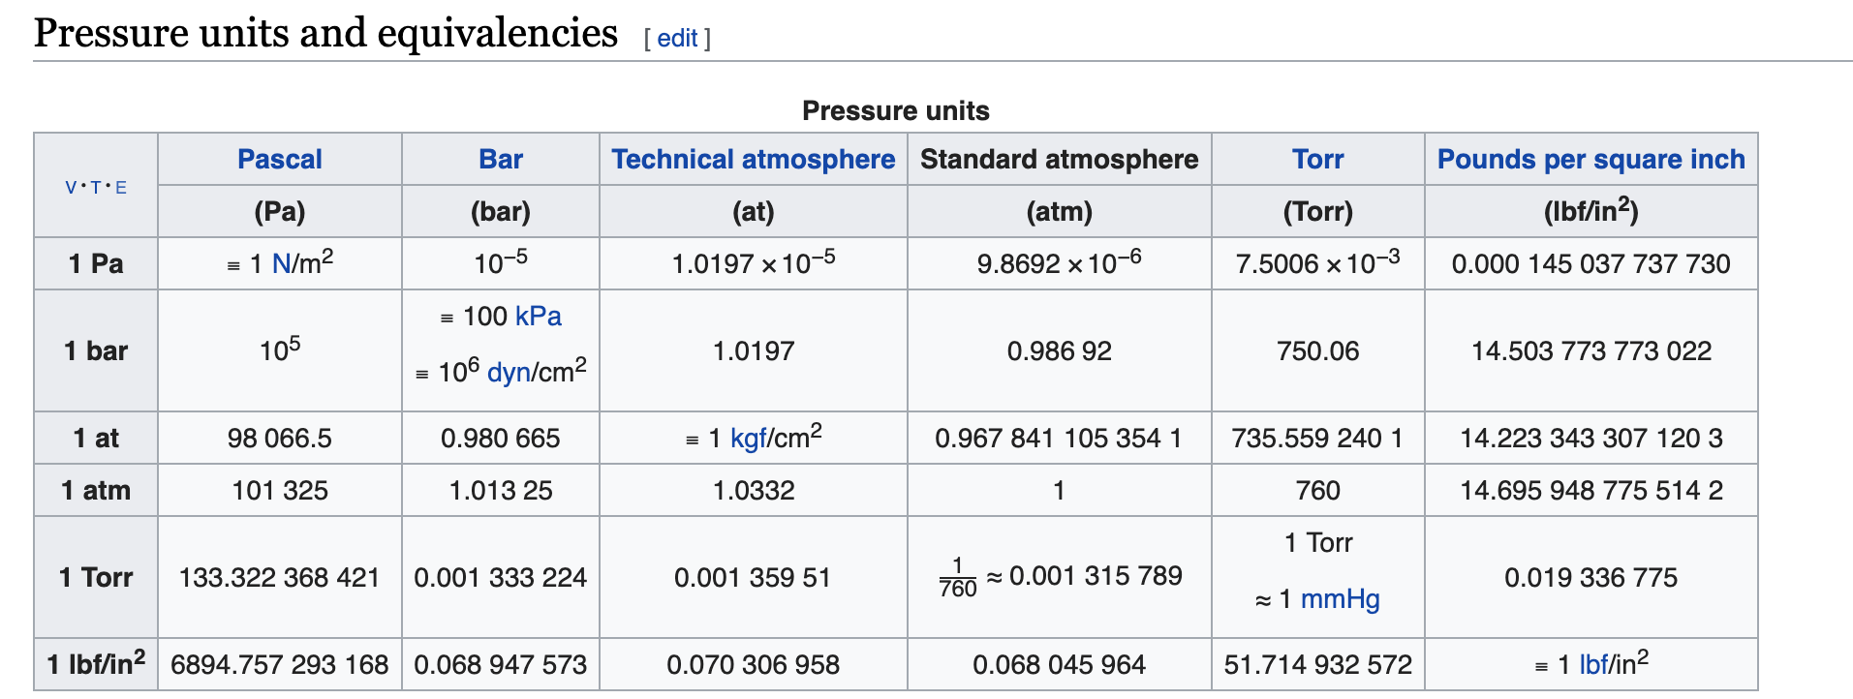

Slide 35
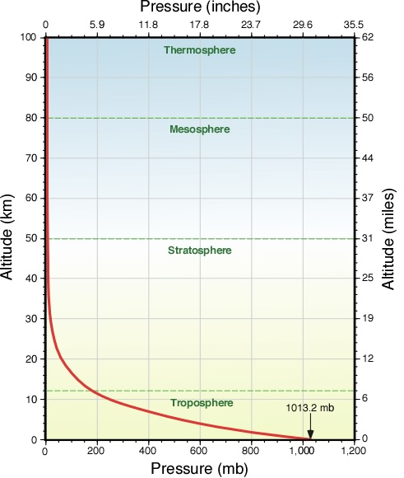

Slide 36
1. Environment

Slide 37
Water Vapor
Water vapor (H₂O) – Extremely important variable gas with short residence time (~10 days)
Water vapor is the invisible gaseous phase of water (you can only see liquid water droplets!)
Atmospheric concentration highest near ocean surface in tropics (~4%)

Slide 38
Outline
Intro to air pollution
Atmospheric Composition
Measures of concentration
Concentration of gases
Concentration and composition of PM
Structure of the Atmosphere
Thermal stratification
Characteristic vertical and horizontal mixing times
Spatial variability of atmospheric composition
Light
Nature of light
Interaction of light and matter
Sunlight and its propagation through the atmosphere

Slide 39
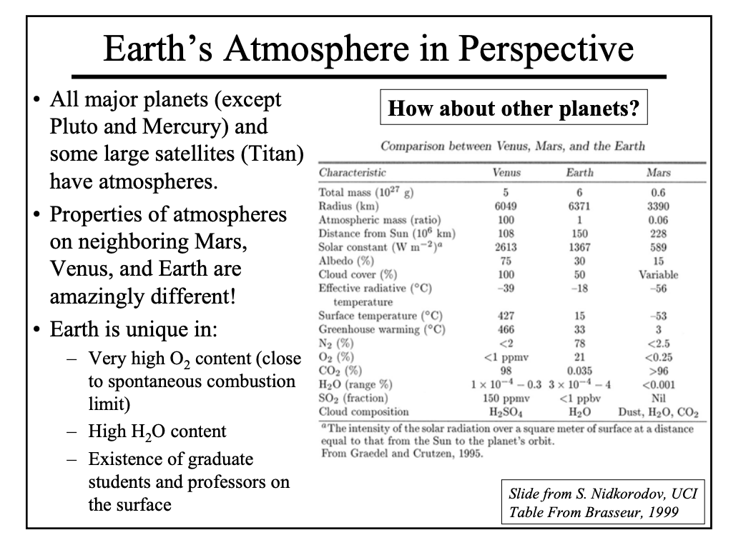

Slide 40
1.1 Mixing ratio or mole fraction C_{X} [mol mol⁻¹]
remains constant when air density changes
e robust measure of atmospheric composition
SPECIES | MIXING RATIO (dry air) [mol mol⁻¹]
Nitrogen (N₂) | 0.78
Oxygen (O₂) | 0.21
Argon (Ar) | 0.0093
Carbon dioxide (CO₂) | 380x10⁻⁶
Neon (Ne) | 18x10⁻⁶
Ozone (O₃) | (0.01-10)x10⁻⁶
Helium (He) | 5.2x10⁻⁶
Methane (CH₄) | 1.7x10⁻⁶
Krypton (Kr) | 1.1x10⁻⁶
Air also contains variable H₂O vapor (10⁻⁶-10⁻² mol mol⁻¹) and aerosol particles
Trace
gases
Trace gas concentration units:
1 ppmv = 1 µmol mol⁻¹ = 1x10⁻⁶ mol mol⁻¹
1 ppbv = 1 nmol mol⁻¹ = 1x10⁻⁹ mol mol⁻¹
1 pptv = 1 pmol mol⁻¹ = 1x10⁻¹² mol mol⁻¹

Slide 41
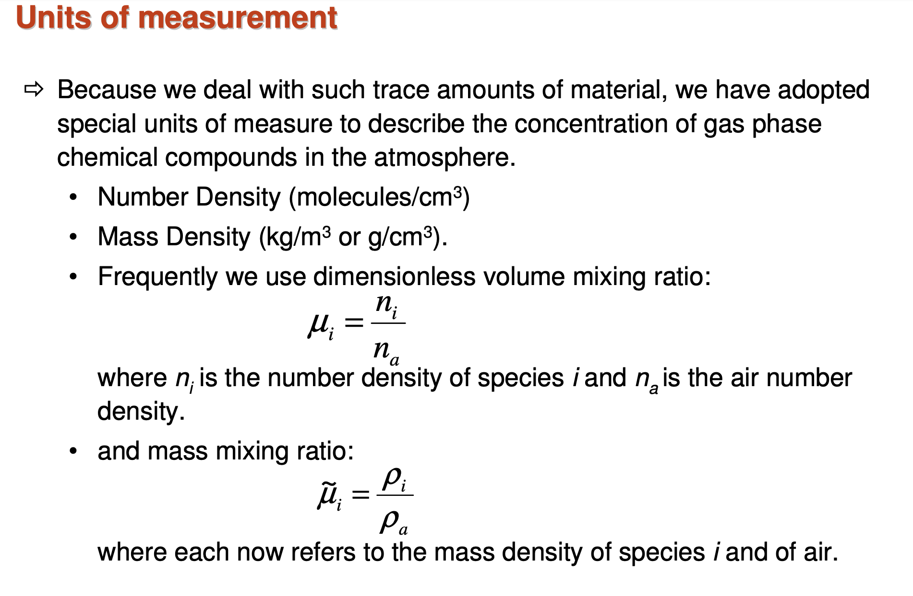

Slide 42
1.2 Number density n_{X} [molecules cm⁻³]
Proper measure for
reaction rates
optical properties of atmosphere
Proper measure for absorption or scattering of radiation by atmosphere
n_{X} and C_{X} are related by the ideal gas law:
n_{a} = air density
A_{v} = Avogadro’s number
P = pressure
R = Gas constant
T = temperature
M_{X}= molecular mass of X
Also define the mass concentration (g cm⁻³):

Slide 43
The mixing ratio CX of a gas X (equivalently called the mole fraction) is defined as the number of moles of X per mole of air.
It is given in units of mol/mol (abbreviation for moles per mole), or equivalently in units of v/v (volume of gas per volume of air) since the volume occupied by an ideal gas is proportional to the number of molecules.
Pressures in the atmosphere are sufficiently low that the ideal gas law is always obeyed to within 1%.
The mixing ratio is constant and a robust measure of atmospheric composition.

Slide 44
Water Vapor
Water vapor (H₂O) – Extremely important variable gas with short residence time (~10 days)
Water vapor is the invisible gaseous phase of water (you can only see liquid water droplets!)
Atmospheric concentration highest near ocean surface in tropics (~4%)
Atmospheric concentration lowest in deserts and at high altitudes (near 0%)

Slide 45
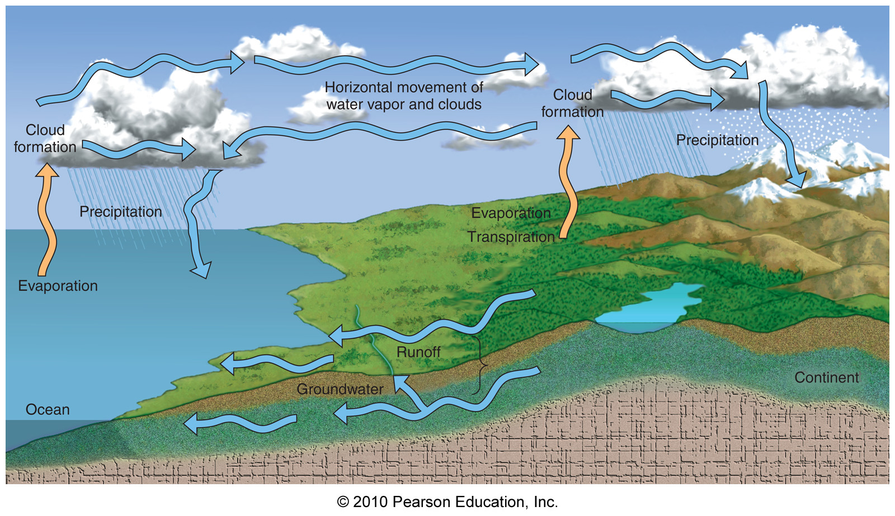
The Hydrologic Cycle

Slide 46
Processes in an atmospheric chemistry model

Slide 47
Climate System

Slide 48
Carbon cycle

Slide 49
Other GHGs
N₂O mixing ratios show an increase from a pre-industrial value of around 270 ppb (Prather et al., 2001) to 318 – 319 ppb in early 2004
CFC-11, CFC-12, CFC-13, HCFC-22, and CCl₄ concentrations increased from a pre-industrial value of zero to 268 ppt, 533 ppt, 4 ppt, 132 ppt, and 102 ppt respectively (1998 concentrations) - leads to radiative forcings of 0.07 W m⁻², 0.17 W m⁻², 0.03 W m⁻², 0.03 W m⁻² and 0.01 W m⁻²
Ozone: approximate doubling of concentrations between the pre-industrial and present day.

Slide 50
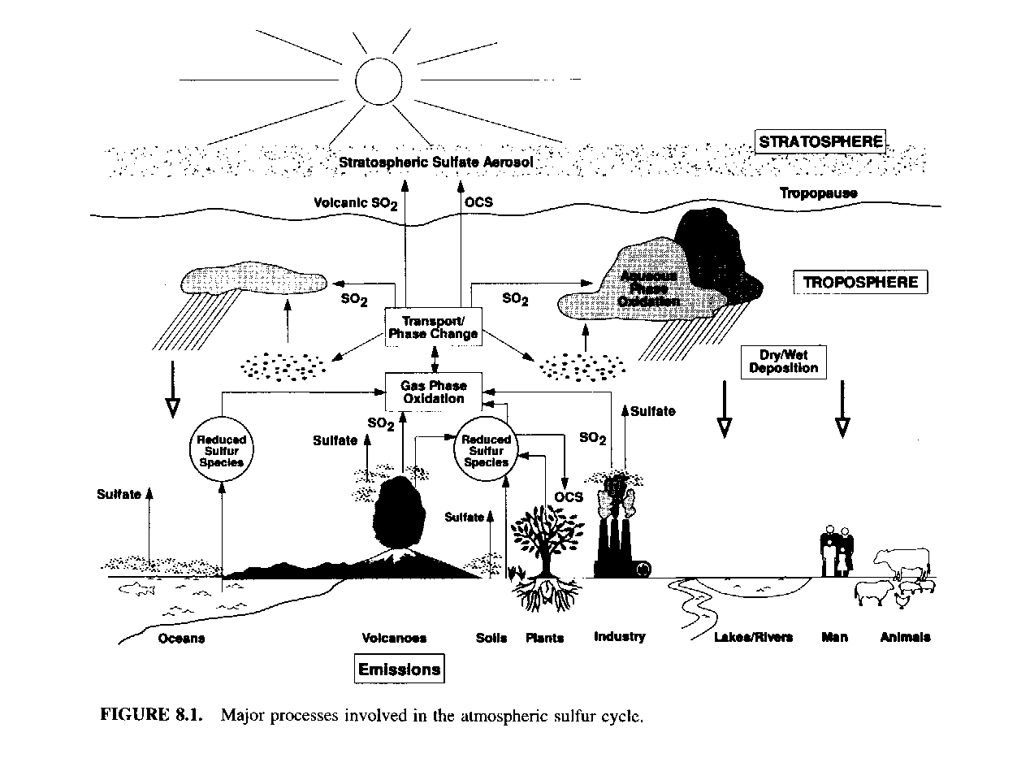
Sulfur cycle

Slide 51
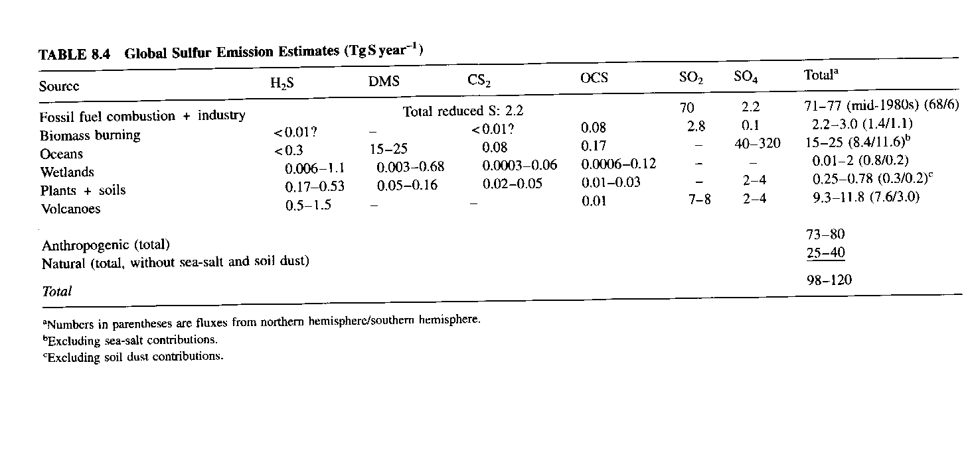
Sulfur emissions

Slide 52
Ozone
Ozone (O₃) – A beneficial and harmful variable gas

Slide 53
Ozone
Ozone (O₃) – A beneficial and harmful variable gas
O₃ concentrations in the stratosphere (~10-30 miles above sea level) are relatively high (15 ppm), occurs from natural chemical reactions
Absorbs UV radiation!!

Slide 54
Ozone
Ozone (O₃) – A beneficial and harmful variable gas
O₃ concentrations in the stratosphere (~10-30 miles above sea level) are relatively high (15 ppm), occurs from natural chemical reactions
Absorbs UV radiation!!
O₃ concentration near earth’s surface is usually near zero, but can increase to 0.15 ppm through chemical reactions in polluted air
Irritant!!

Slide 55
Stratospheric Ozone Creation and Destruction
Natural ozone cycle
O₂ + uv --> O + O
O₂ + O --> O₃
O₃ + uv --> O + O₂

Slide 56
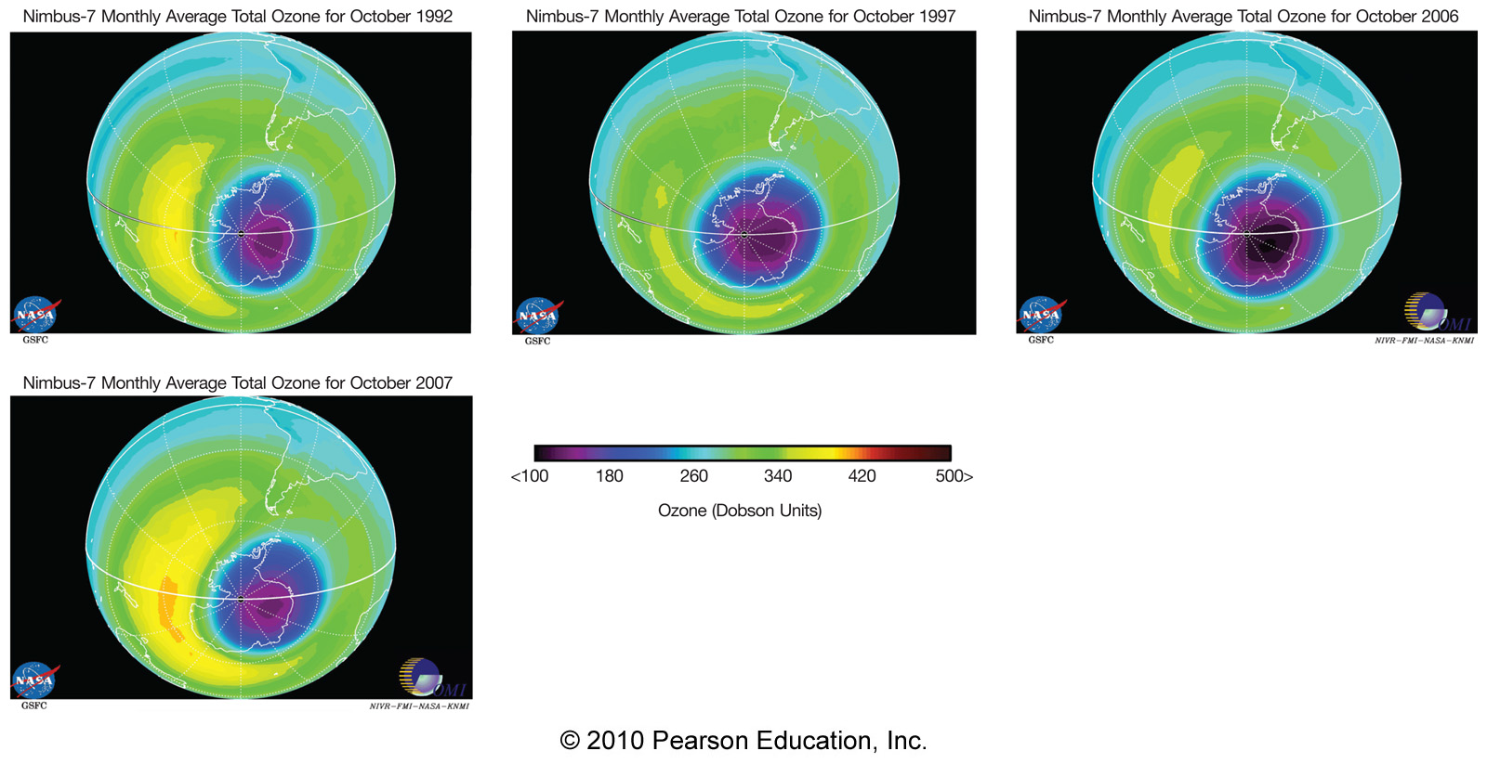
Stratospheric Ozone Creation and Destruction
Natural ozone cycle
O₂ + uv --> O + O
O₂ + O --> O₃
O₃ + uv --> O + O₂
After introduction of CFCs
CFC + uv --> Cl + CFC^{byproduct}
Cl + O₃ --> ClO + O₂
O + ClO --> Cl + O₂

Slide 57
The Antarctic Ozone Hole
The ozone hole is defined as the area having less than 220 dobson units (DU) of ozone in the overhead column (i.e., between the ground and space).
a unit of measurement for the total amount of ozone in the atmosphere above a point on the earth's surface, one Dobson unit being equivalent to a layer of pure ozone 0.01 mm thick at standard temperature and pressure.

Slide 58
Ozone
O₃
a gas composed of three atoms of oxygen
bluish gas that is harmful to breathe
Nearly 90% of the Earth's ozone is in the stratosphere and is referred to as the ozone layer
Ozone absorbs a band of ultraviolet radiation called UVB

Slide 59
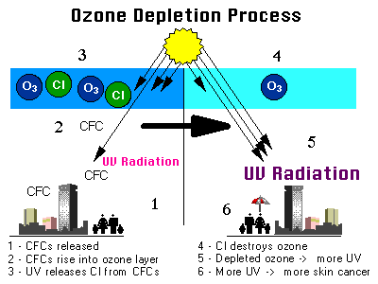

Slide 60
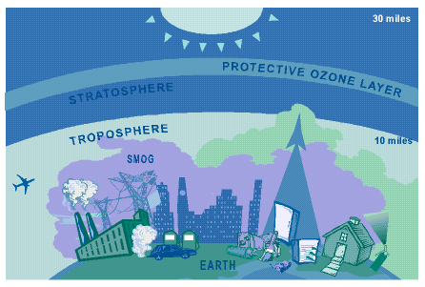

Slide 61
Ozone-Depleting Substance(s) (ODS):
CFCs,
HCFCs,
halons,
methyl bromide,
carbon tetrachloride, and
methyl chloroform.

Slide 62
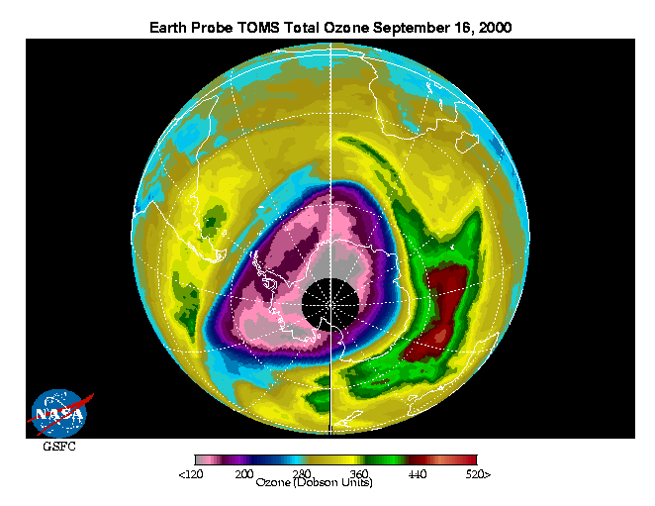
The Antarctic Ozone Hole
The ozone hole is defined as the area having less than 220 dobson units (DU) of ozone in the overhead column (i.e., between the ground and space).
Source: http://jwocky.gsfc.nasa.gov/multi/recent_ozone91200.gif

Slide 63
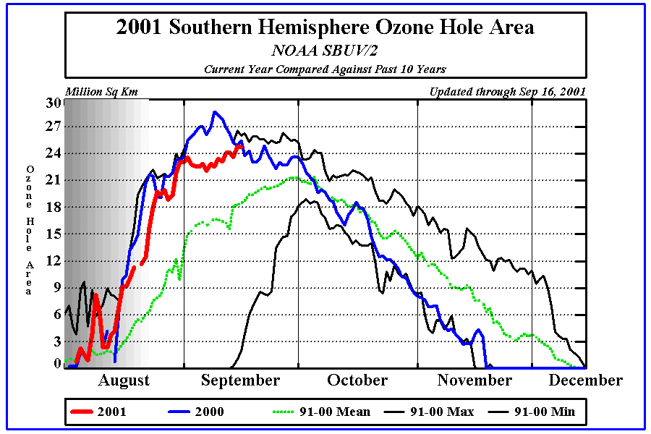
http://www.cpc.ncep.noaa.gov/products/stratosphere/sbuv2to/ozone_hole_plot.gif

Slide 64
Ground Level
Ozone
Formation

Slide 65
Ground level Ozone Formation
Secondary Pollutant
VOCs+ NO_{x} → Ozone
In presence of sunlight
Ozone + NO_{X} + HCs → Smog (haze)

Slide 66
Photochemical Smog
O₃
CO
PAN
Haze
NO₂
CO
HC
NO
CO, RH
6:00AM 12NOON 3:00 PM

Slide 67
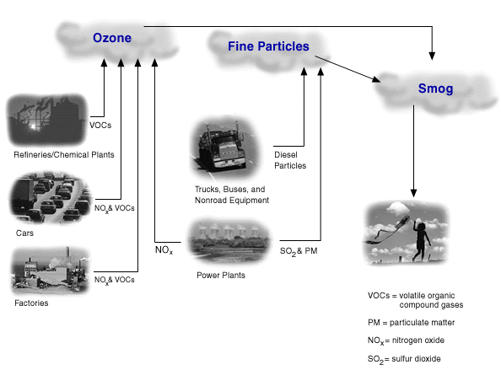
Smog Sources
Source: http://www.epa.gov/oar/oaqps/regusmog/smog.html

Slide 68
Smog Sources
Source: http://www.epa.gov/oar/oaqps/regusmog/smog.html

Slide 69
Atmospheric Chemistry - Take 2
Energy equation in the atmosphere:
E = hC/λ
Where λ is radiation wavelength
N₂ + hυ  2N (λ < 126 nm) ΔHº = 945 kJ mol⁻¹
O₂ + hυ  2O (λ < 240 nm) ΔHº = 498 kJ mol⁻¹
N₂ (g) + O₂ (g)  2NO (g) ΔGº = +173 kJ mol⁻¹
Does not occur at ambient T but does at high T
(engine combustion ~ 2500°C)
The reverse reaction is favored thermodynamically but too slow at ambient T (kinetics!) ➔ other reactions

Slide 70
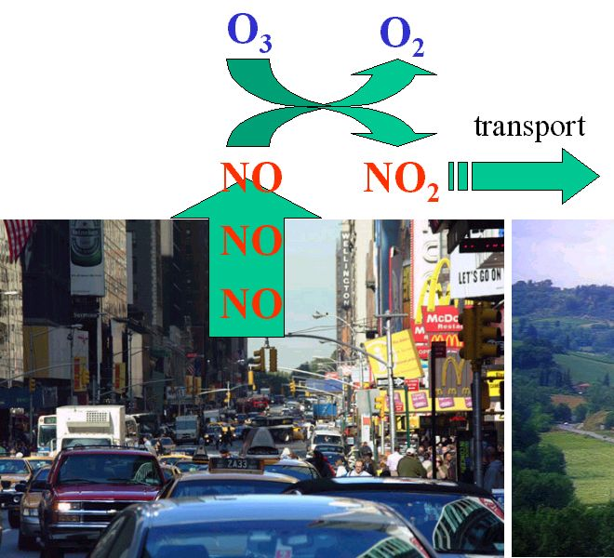
Atmospheric Chemistry - Tropospheric ozone
2NO + O₂  2NO₂
NO + O₃  NO₂ + O₂

Slide 71
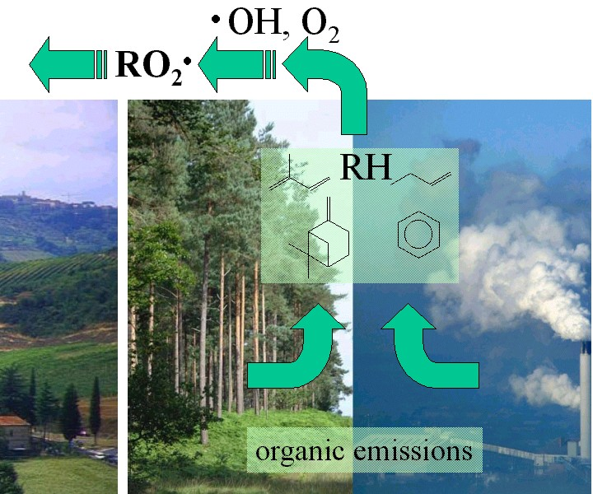
Atmospheric Chemistry - Tropospheric ozone
The second partner needed in the ozone formation cycle are organic peroxides and free radicals (Organic molecules are emitted from forests and other plants but also from human sources - e.g. solvents or fuel at filling stations)
CO + OH  H + CO₂
CH₄ + OH  CH₃ + H₂O
φCH₃ + OH  φCH₂ + H₂O
ROOH + OH  ROO + H₂O

Slide 72
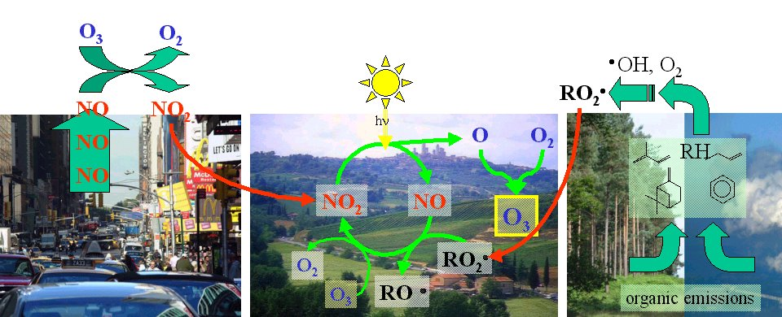
Atmospheric Chemistry - Tropospheric ozone
NO₂ (hυ, λ<400 nm)  NO + O
O + O₂ + M  O₃
ROO + NO  RO + NO₂
NO + O₃  NO₂ + O₂

Slide 73
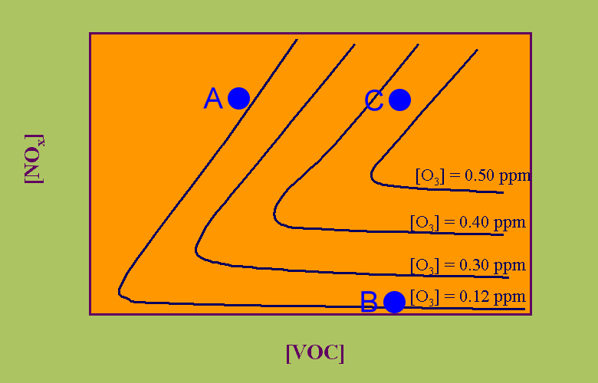
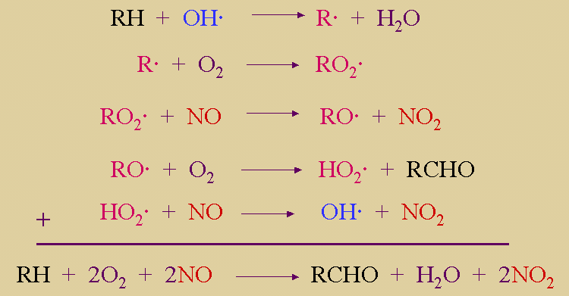
Atmospheric Chemistry - Tropospheric ozone
If no nitrogen oxides are available, the reaction cycle cannot take place.
If too much nitrogen oxides are available the excess of nitrogen oxide NO reacts not only with the peroxy-radicals but removes the ozone again.
If no sunlight is available NO cannot be recycled again and the formation of peroxy-radicals is not sufficient.

Slide 74
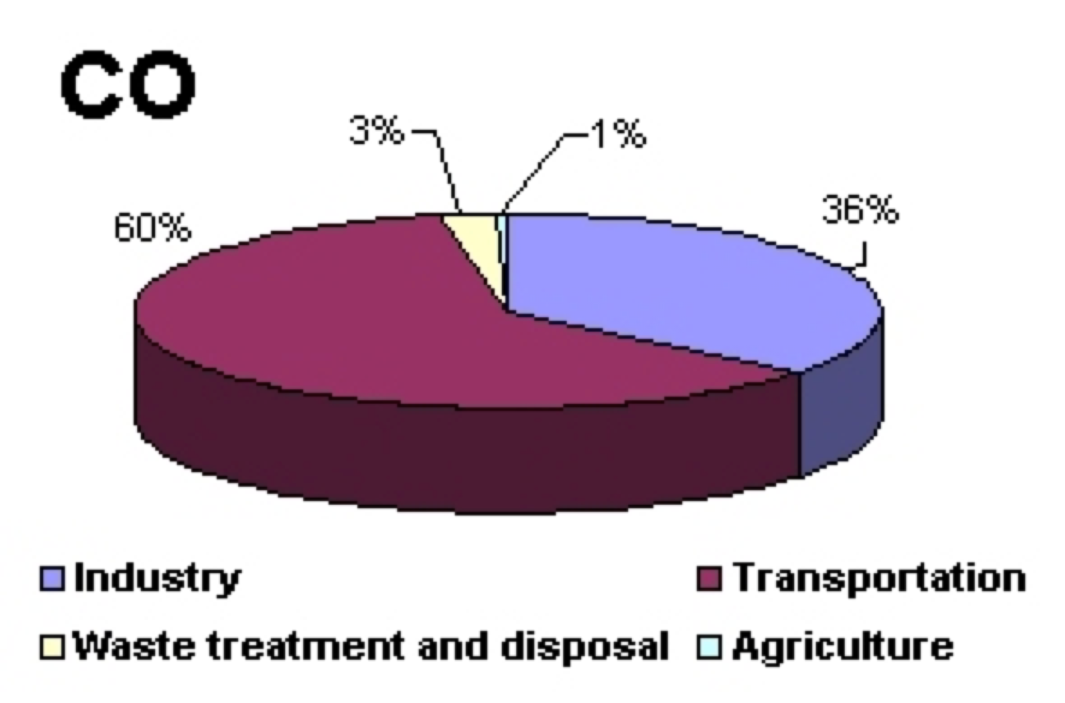
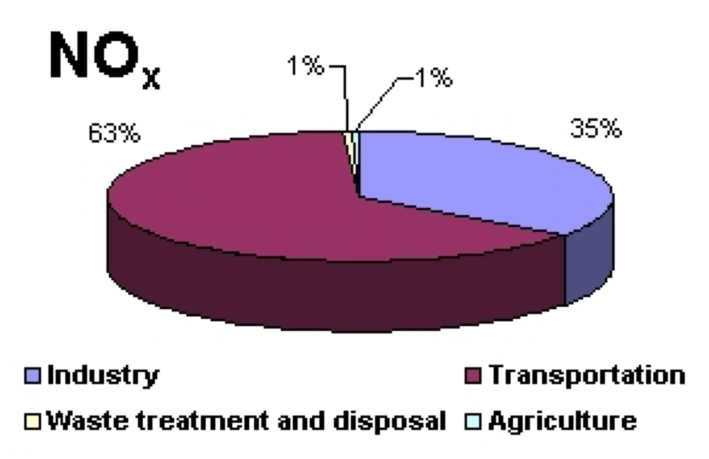
Atmospheric Chemistry - Take 1
Sources of CO and NO_{x} Emissions in Europe
In Europe, in 2001, 30 679 Gg of CO was emitted. The main source of anthropogenic CO in the air was transportation (60%), and the industry contributed to 36% of the total emission. Waste management and agriculture were of marginal importance;
Transportation was also the main source of NOx as it delivered 63% of the total emission which amounted 10 056 Gg in 2001. Industry contributed to 35% of the total emission. Again, emissions from waste management and agriculture were of marginal importance.

Slide 75
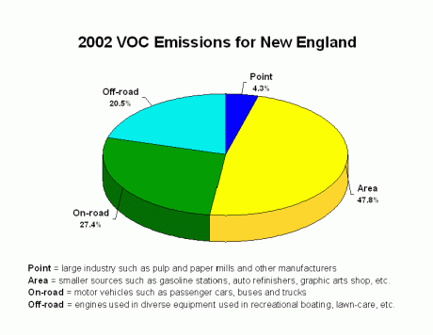
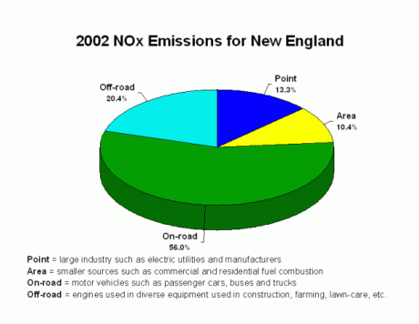
Atmospheric Chemistry - Take 2
Sources of HC and NO_{x} Emissions in New England
Large industry such as chemical manufacturers, and combustion sources such as power plants burning fossil fuels;
Small industry such as gasoline-dispensing facilities, autobody paint shops, and print shops;
On-road automobiles, trucks and buses;
Off-road engines such as aircraft, locomotives, construction equipment and gasoline-powered lawn and garden equipment.

Slide 76
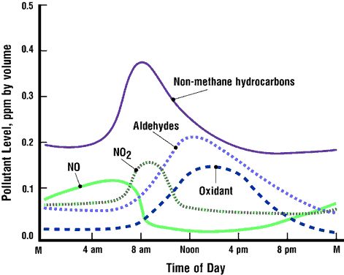
Atmospheric Chemistry - Take 2
Sequence of of chemical species appearing during a photochemical smog event.

Slide 77
Change in regulation of ozone
In July 1997, based on information that the 1-hour ground-level ozone standard did not adequately protect public health, EPA established the 8-hour ozone standard. Scientific information shows that concentrations of ozone in the air can affect human health at low levels and over longer exposure periods concentrations to 0.08 ppm, averaged over eight hours. The 1-hour standard limits ozone concentrations to 0.12 parts per million (ppm), measured in hourly readings

Slide 78
Ozone formation and climate change
Climate change can influence the concentration and distribution of air pollutants through a variety of direct and indirect processes:
modification of biogenic emissions
change of chemical reaction rates
mixed-layer heights that affect vertical mixing of pollutants, and
modifications of synoptic flow patterns that govern pollutant transport.
For example, warmer temperatures can result in increased concentrations of photochemical oxidants and increased rate of O₃ production.

Slide 79
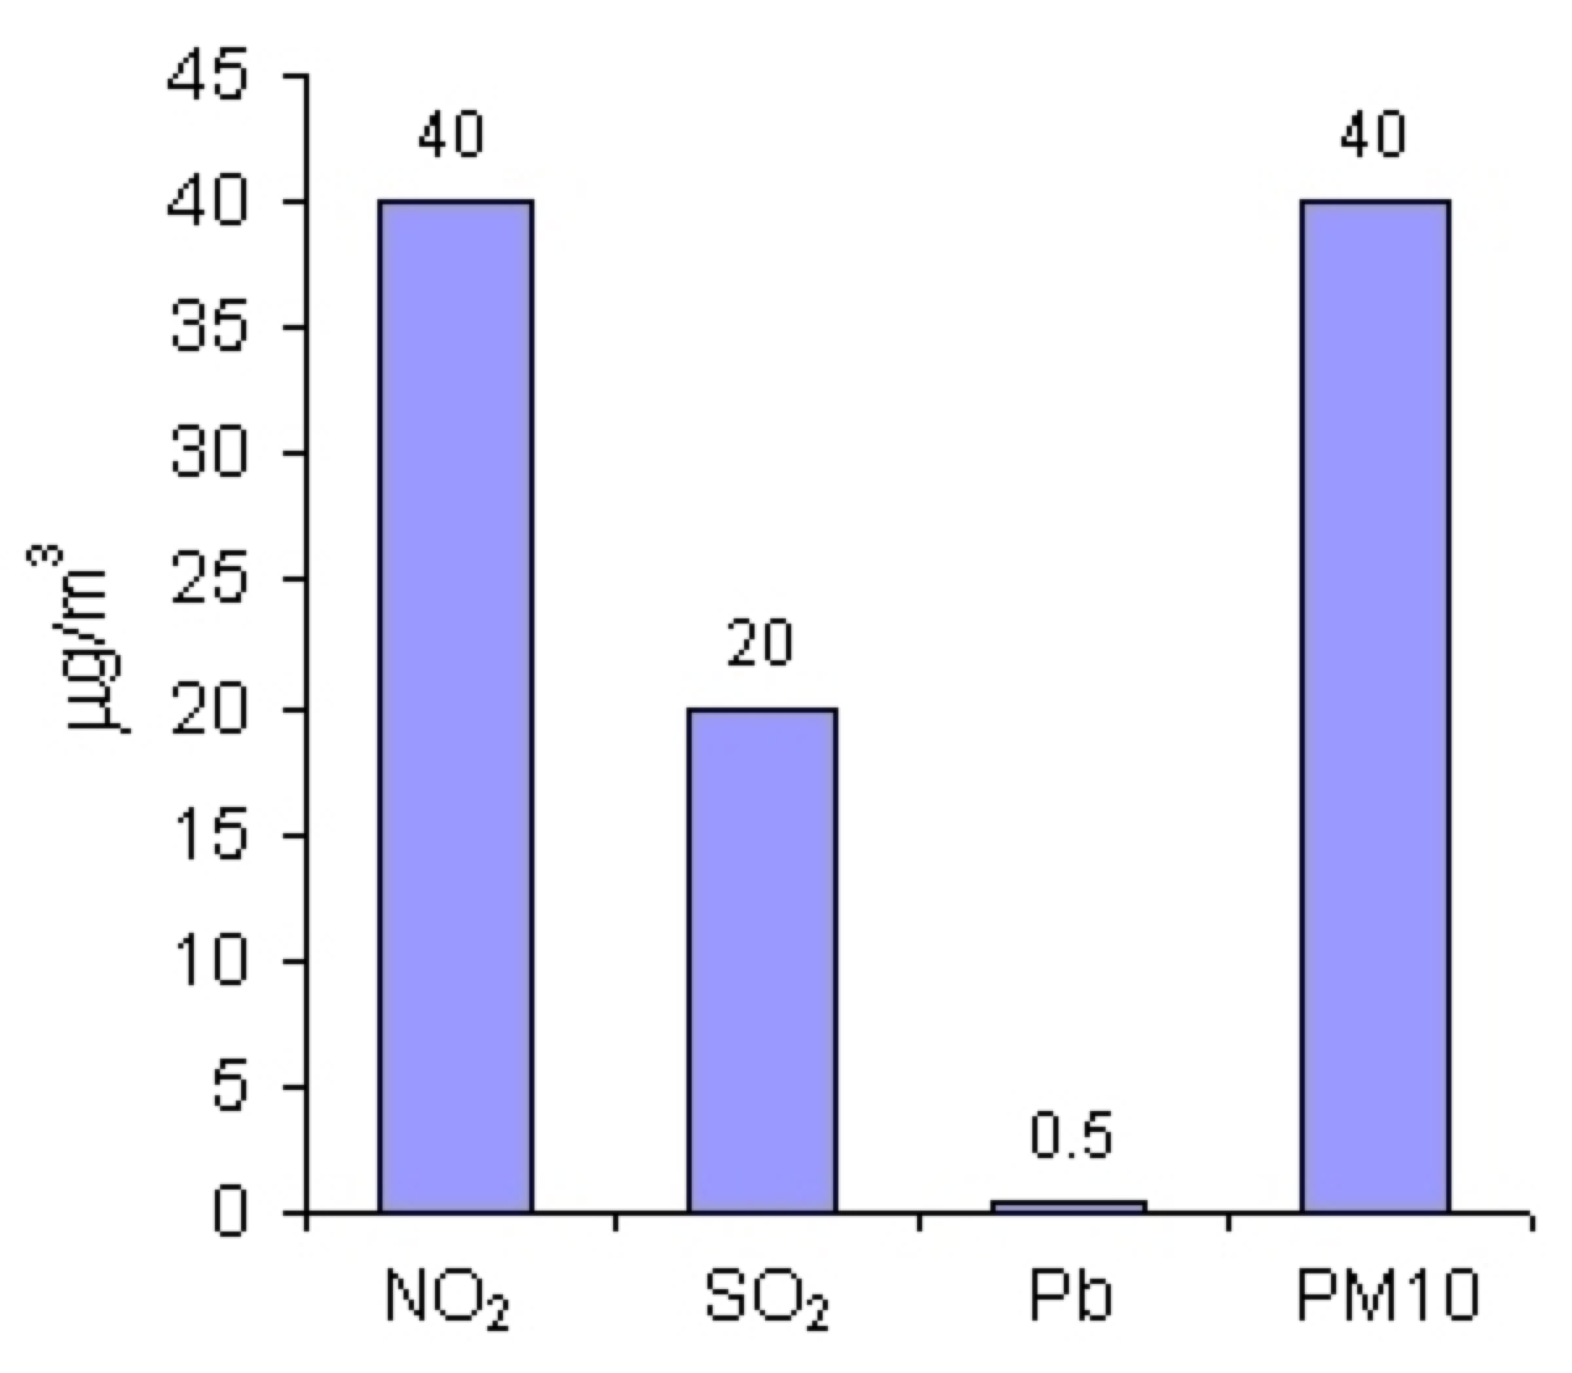
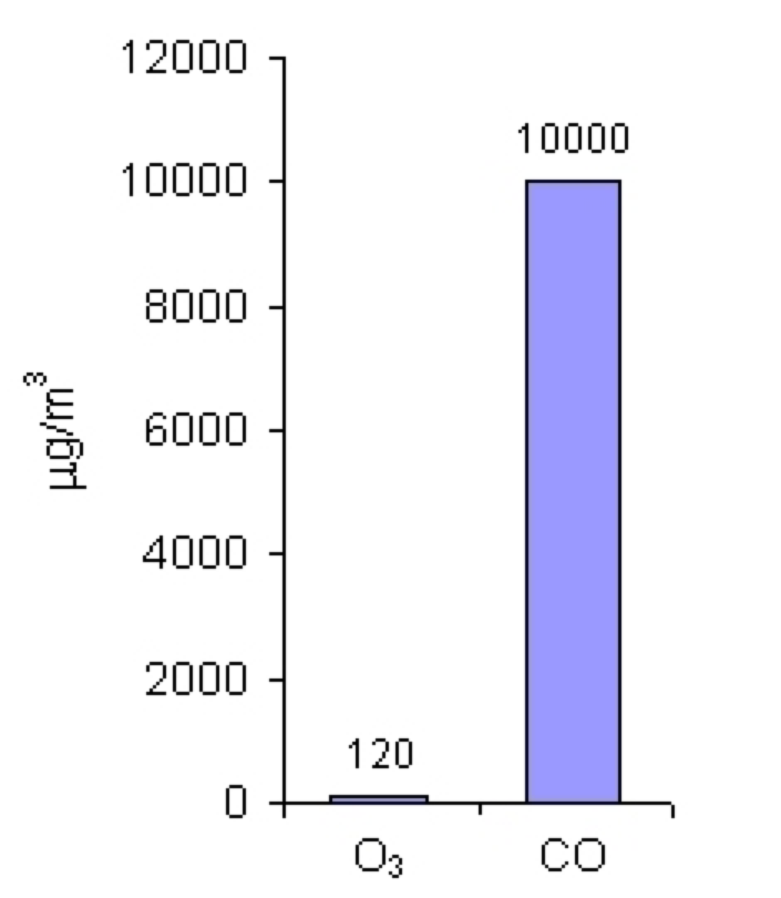
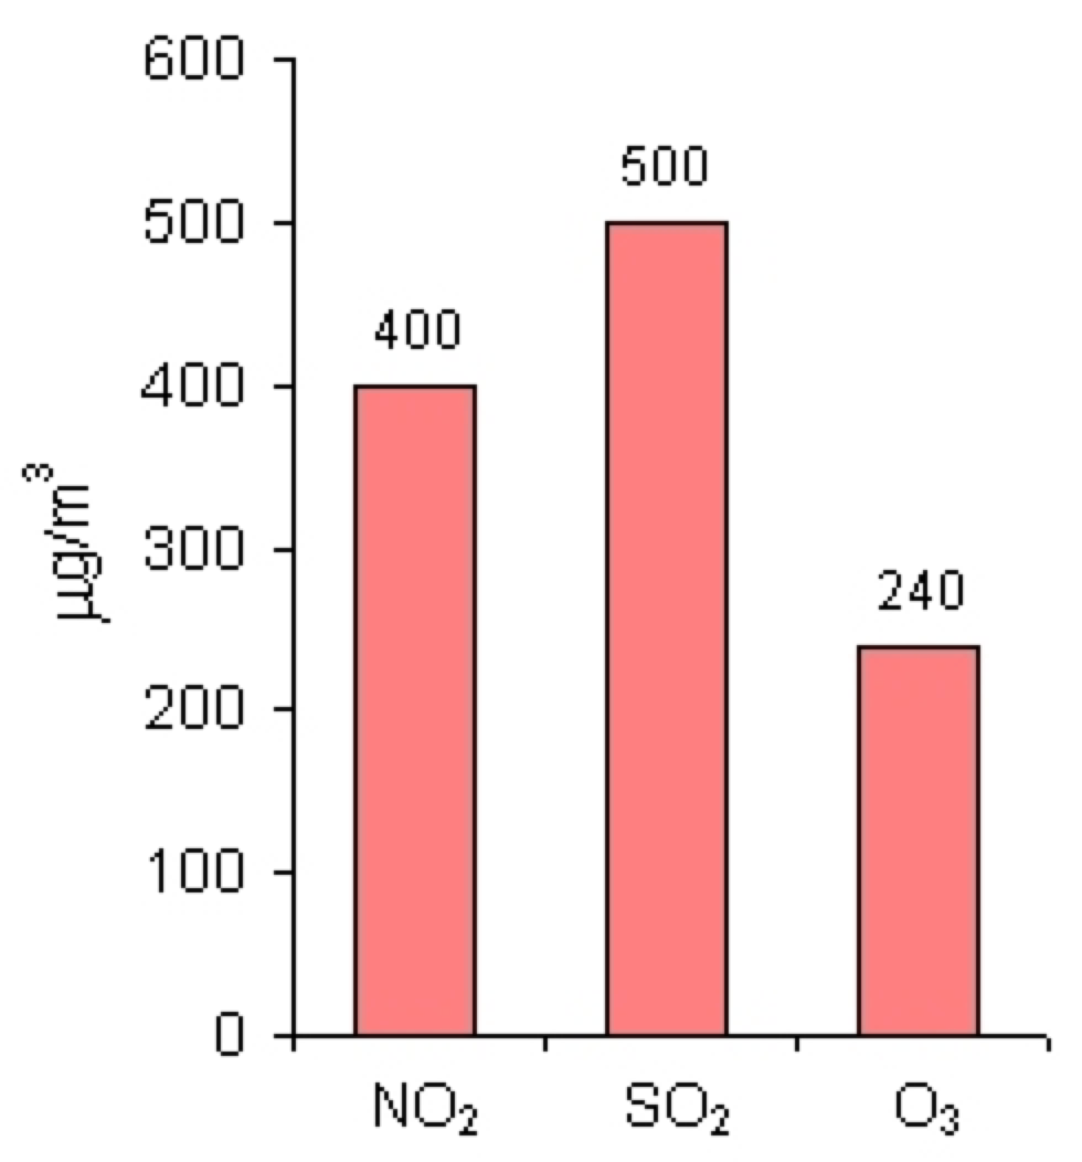
Limit and Alarm Values
For nitrogen dioxide (NO₂), sulphur dioxide (SO₂), lead (Pb) and particulate matter of the diameter up to 10 µm (PM₁₀), the limit values are given as mean annual concentration. .
For ozone (O₃) and carbon monoxide (CO), the limit values are given as mean 8-hour concentration.
For NO₂, SO₂ and O₃, apart from limit values, there are also alarm values established. Those are mean 1-hour concentrations.
Source: Max Plank institute

Slide 80
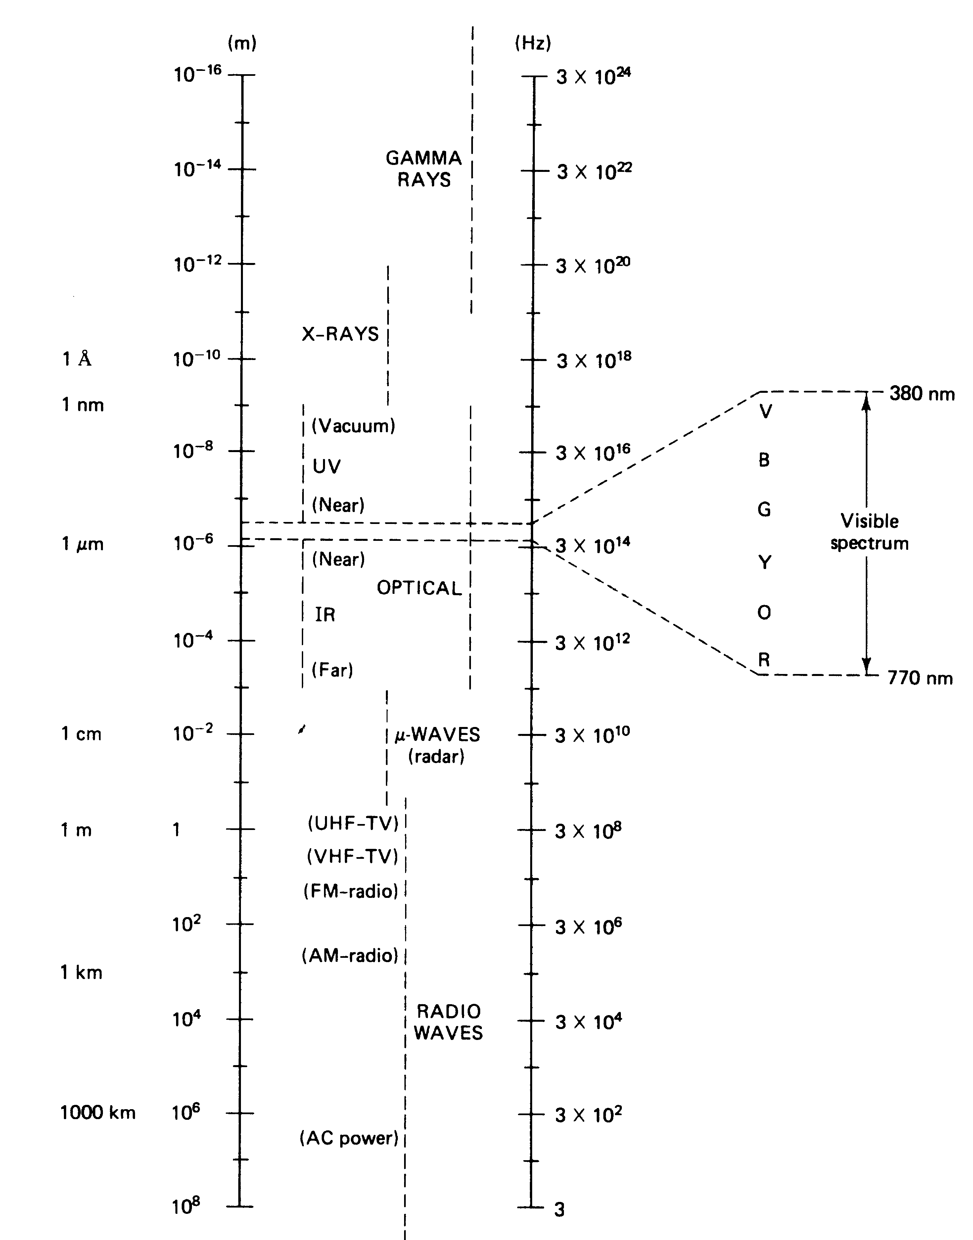
The Electromagnetic Spectrum
increasing energy
decreasing energy

Slide 81
The Electromagnetic Spectrum
Can further subdivide the UV region
UV-C is 200-280 nm (most energetic, completely blocked by ozone layer)
UV-B is 280-320 nm (ground-level UV-B intensity most affected by ozone depletion)
UV-A is 320-280 nm (least energetic, almost all gets through the ozone layer)

Slide 82
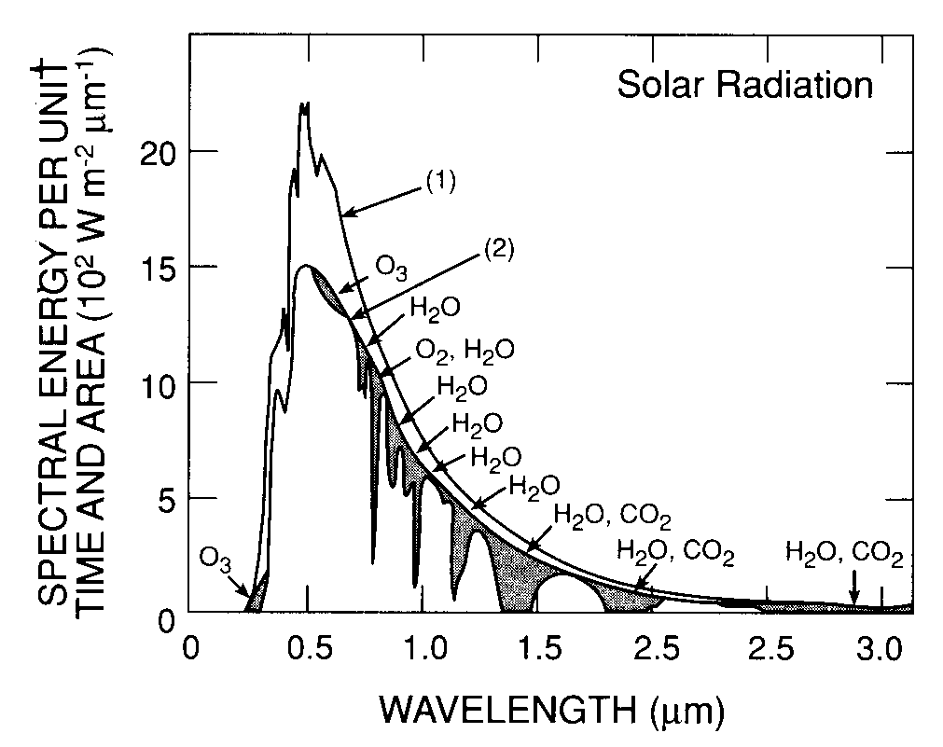
Incident Sunlight Top & Bottom of Atmosphere
Lecture Question
What fraction of incident sunlight is in the uv, visible and ir regions?
8% ultraviolet
39% visible
53% infrared

Slide 83
Atmospheric oxidation of methane
O¹D +H₂O→ 2OH
O¹D +N₂,O₂→ O³P
↓
O₃
Termination
O₃
Yield of OH and loss of
O₃ depend on humidity
CH₄ removed
mainly by reaction
with OH
NO₂
light
CH₄
OH
NO₂
O₃
H₂O
NO
Termination
CH₃O₂
HO₂
Termination
HO2
HO₂
NO
NO₂
High NOx route
Ozone formation
Polluted atmos
Low NOx route
Ozone destruction
(background atmos)
O₃

Slide 84
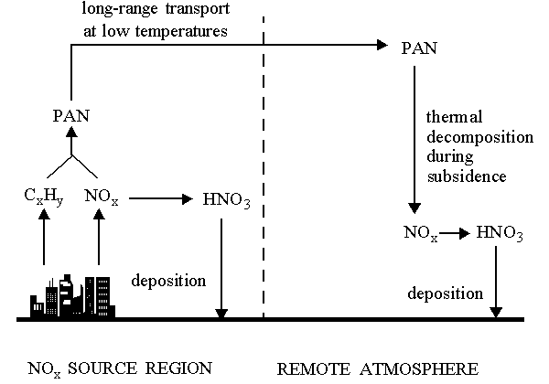
PAN – peroxy acetyl nitrate
PAN is formed from reactions of the acetyl peroxy radical and NO2:
e.g. CH3CHO + OH (+O2) → CH3COO2 + H2O
CH3COO2 + NO2 CH3COO2NO2 (PAN)
PAN is a reservoir compound for nitrogen oxides and provides a mechanism for their transport, especially in the upper troposphere. It provides a means of carrying nitrogen oxides from polluted to less polluted regions. It is a major player in the intercontinental transport of pollutants

Slide 85
Methane
Methane (CH₄) – A variable gas with residence time ~10 years that has high potential for greenhouse warming

Slide 86
Methane
Methane (CH₄) – A variable gas with residence time ~10 years that has high potential for greenhouse warming
Sources - 1) Rice cultivation, wetlands
2) Mining
3) Biomass burning
4) Fossil fuel extraction
5) Animal digestion

Slide 87
Methane
Methane (CH₄) – A variable gas with residence time ~10 years that has high potential for greenhouse warming
Sources - 1) Rice cultivation, wetlands
2) Mining
3) Biomass burning
4) Fossil fuel extraction
5) Animal digestion
Sinks - 1) Atmospheric chemical reactions

Slide 88
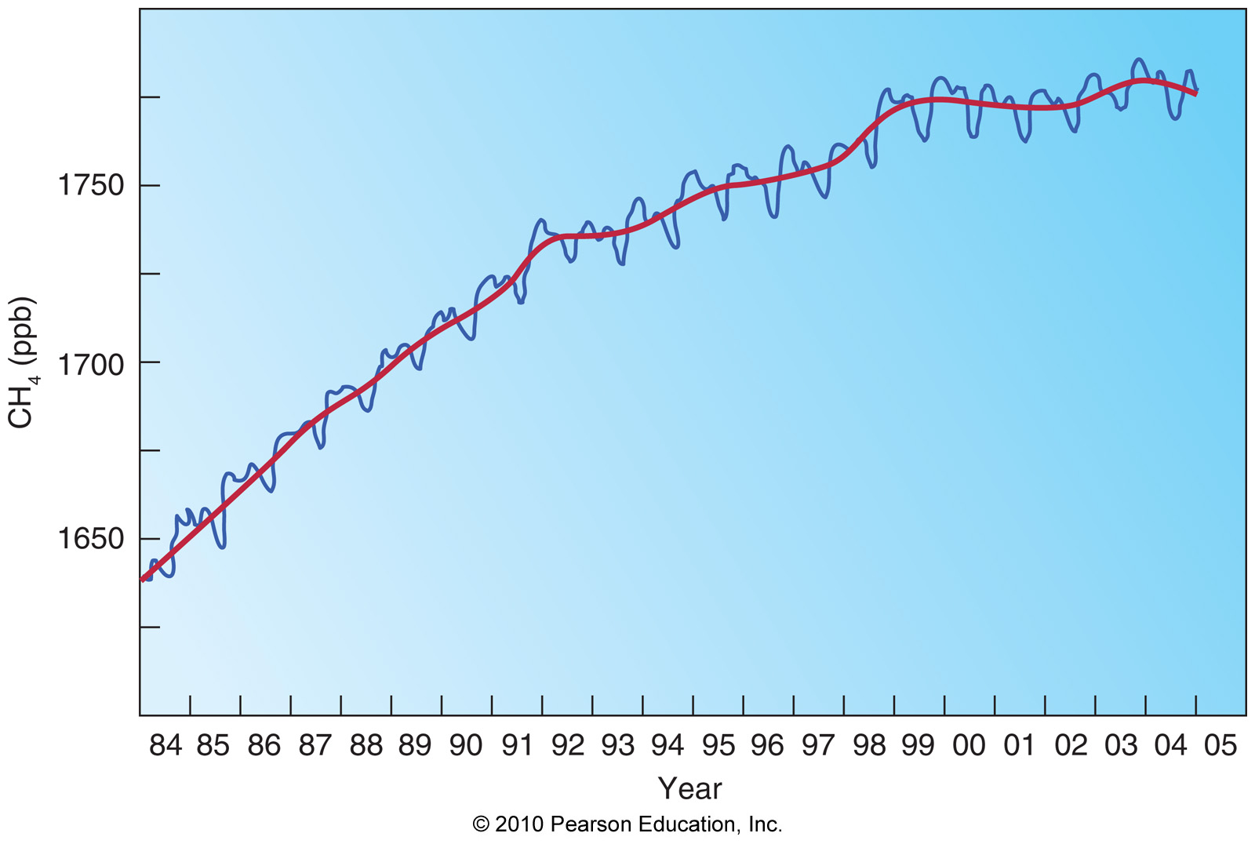
Methane

Slide 89
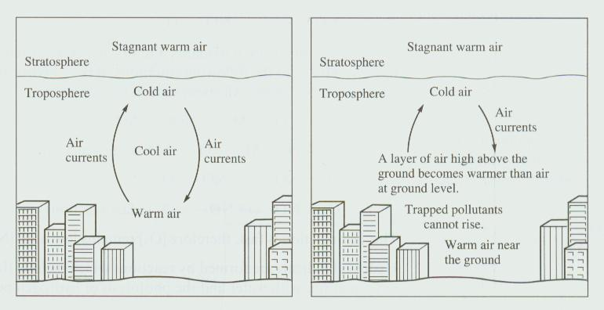
Temperature Inversion

Slide 90
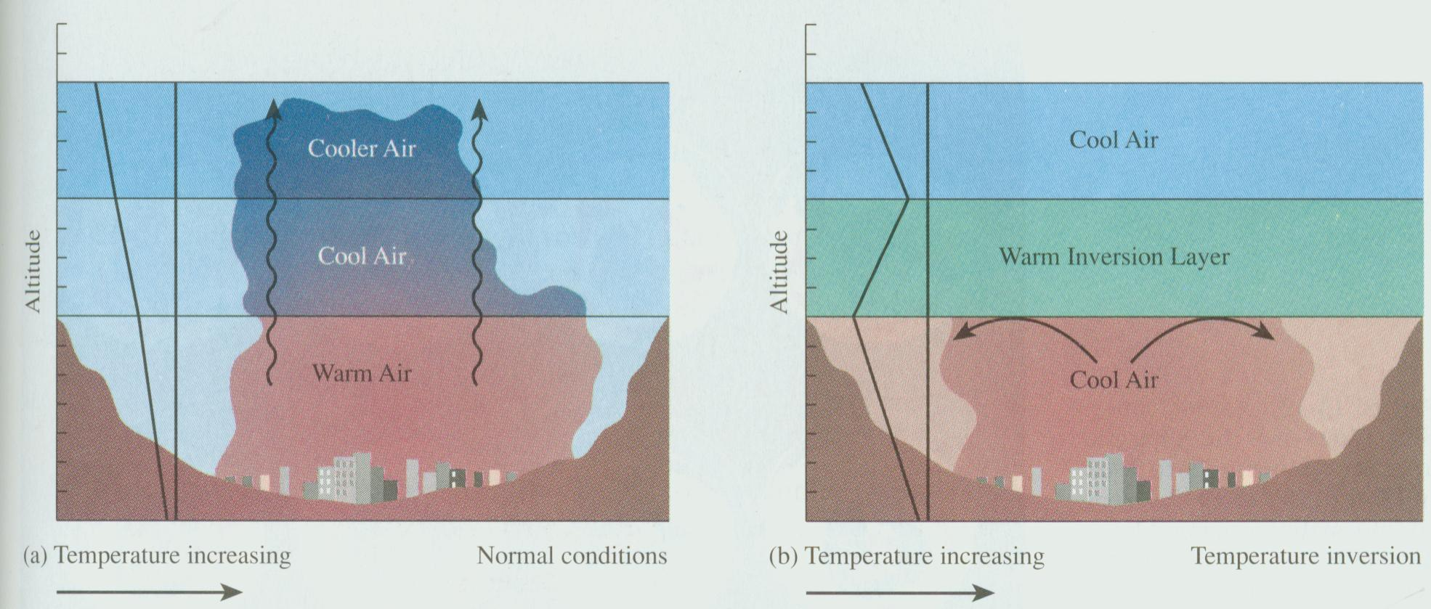

Slide 91
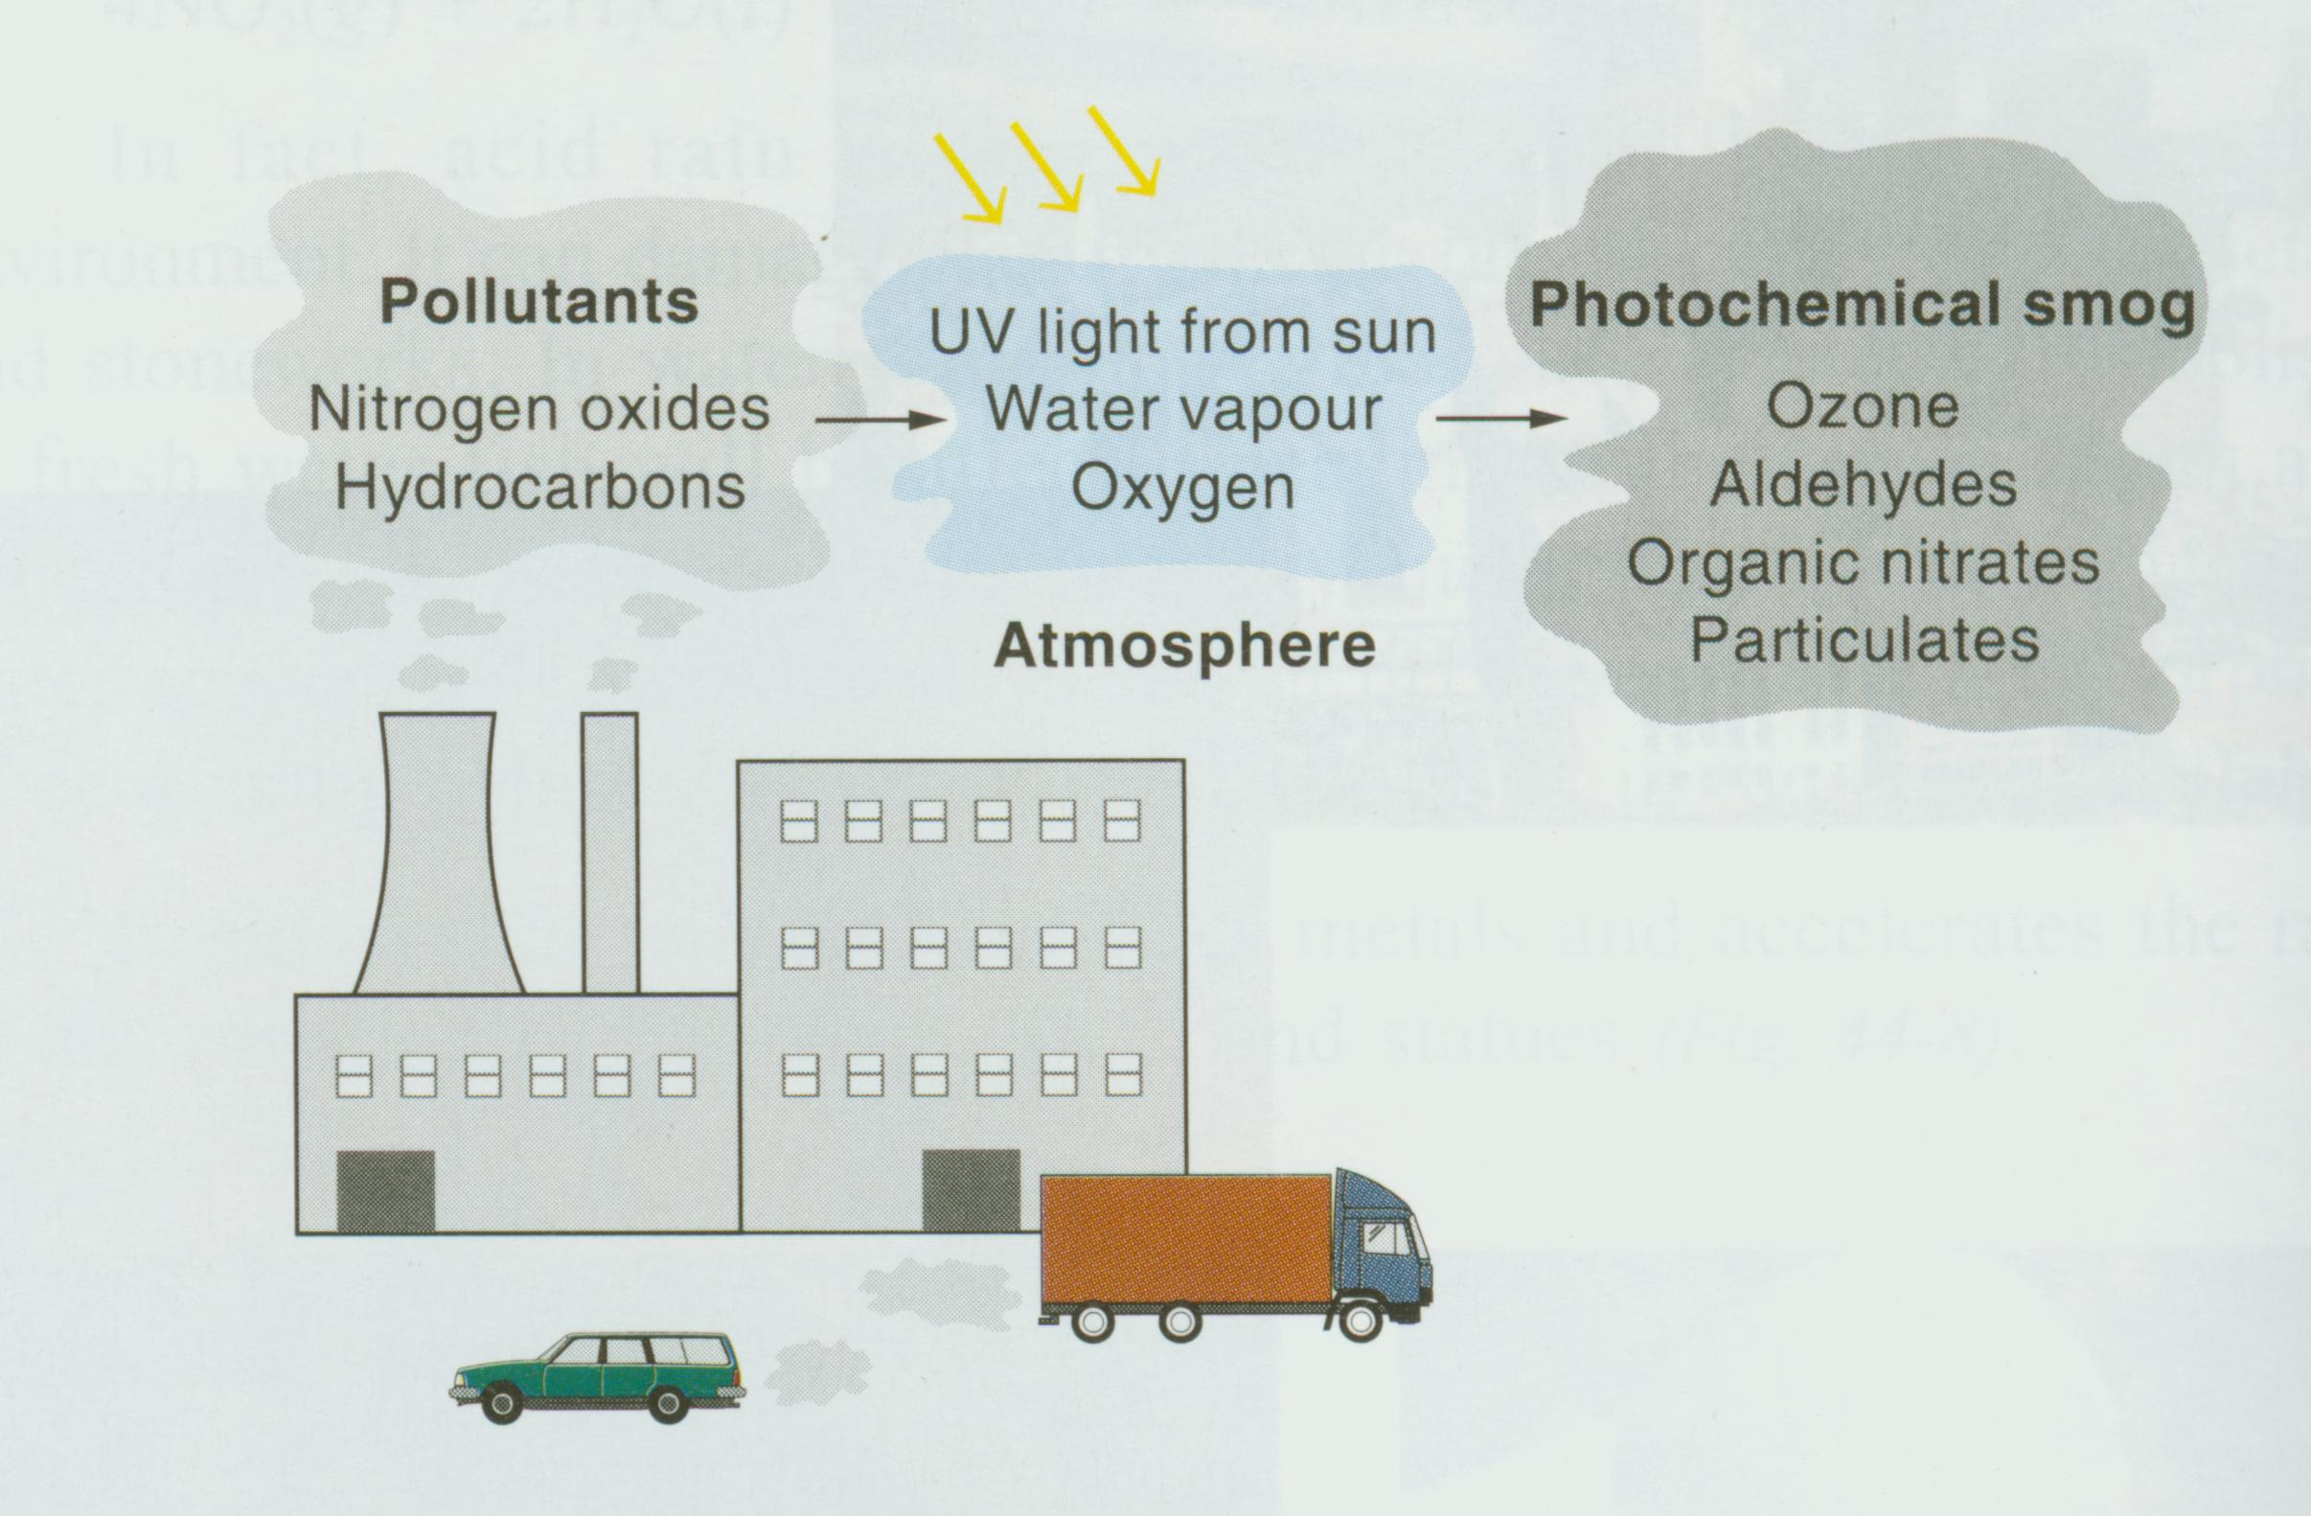
Formation

Slide 92
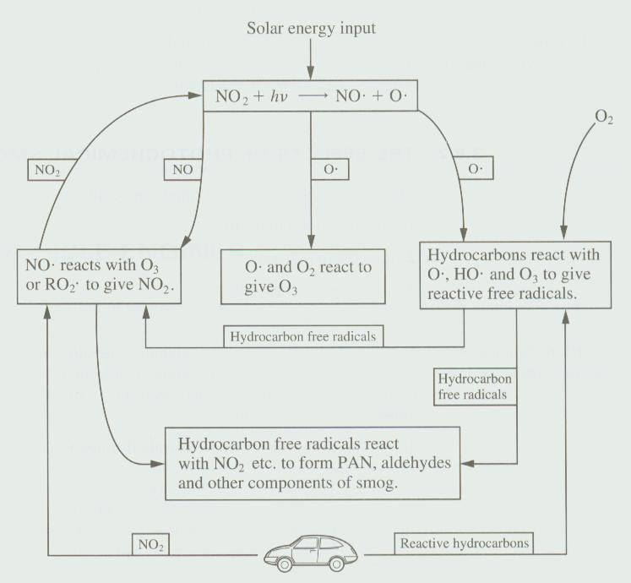

Slide 93
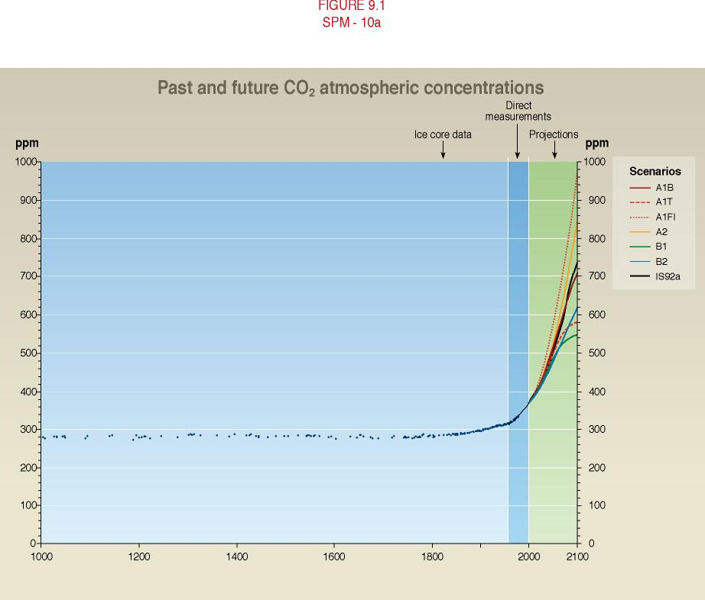
Our Atmosphere is Changing
During the last century, the atmospheric concentration of greenhouse gases and their radiative forcing have continued to rise as a result of human activities.
Global average surface temperatures have increased by about 0.6 °C.
Global average sea level has risen and ocean heat content has increased.
“The balance of evidence suggests a discernable human influence on global climate” (IPCC, SAR, 1995)
“There is new and stronger evidence that most of the warming observed over the last 50 years is attributable to human activities” (IPCC, TAR, 2001)
CO2 Concentrations and Global Average Temperatures Will Continue to Rise
Pre-industrial level: 280 ppm
Current level: 360 ppm
Level in 2100: ~700 ppm with large uncertainty
Source: IPCC, 2001
Notes:
Most of the increase in global temperature since the late 19th century has occurred in two distinct periods: 1910 to 1945 and since 1976. The rate of increase of temperature for both periods is about 0.15°C/decade. Recent warming has been greater over land compared to oceans; the increase in sea surface temperature over the period 1950 to 1993 is about half that of the mean land-surface air temperature. The high global temperature associated with the 1997 to 1998 El Niño event stands out as an extreme event, even taking into account the recent rate of warming. In the mid- and high latitudes of the Northern Hemisphere over the latter half of the 20th century, it is likely that there has been a 2 to 4% increase in the frequency of heavy precipitation events. Increases in heavy precipitation events can arise from a number of causes, e.g., changes in atmospheric moisture, thunderstorm activity and large-scale storm activity.

Slide 94
Some Expected Impacts
Sea level projected to rise 0.09 to 0.88m by 2100 with significant regional variations.
Extreme weather events are projected to increase.
Impacts on biodiversity generally negative.
Socioeconomic systems could show net economic benefits for small amounts of warming, but potentially large negative impacts under greater warming.
Increased water availability in some water-scarce regions, but decreased water availability in many water scarce regions.
Initially increased agricultural productivity in some mid-latitude regions, but decreased in the tropics and sub-tropics.
Significant disruptions of ecosystems from fire, drought, pest infestation, species invasion, etc.
Changes in productivity and composition of ecological systems, with coral reefs, boreal forests, arctic and montane regions being particularly vulnerable.
Increased risk of floods, potentially displacing tens of millions of people.
Increased incidence of heat stress mortality, and vector-borne diseases.
Some impacts effectively irreversible over many generations (thermohaline circulation, Ice sheets, migration of plant species). Thermohaline disruption is uncertain, but ice sheet melt and plant species migration are highly probable.
Notes:
Tide gauge data show that global average sea level rose between 0.1 and 0.2 metres during the 20th century. Global ocean heat content has increased since the late 1950s, the period for which adequate observations of sub-surface ocean temperatures have been available. There has been a widespread retreat of mountain glaciers in non-polar regions during the 20th century.
Flood magnitude and frequency could increase in many regions as a consequence of increased frequency of heavy precipitation events, which can increase runoff in most areas as well as groundwater recharge in some floodplains. Most studies indicate that global mean annual temperature increases of a few °C or greater would prompt food prices to increase due to a slowing in the expansion of global food supply relative to growth in global food demand (established, but incomplete). It is established, though incompletely, that climate change, mainly through increased extremes and temporal/ spatial shifts, will worsen food security in Africa. Substantial warming and increases in precipitation are projected for polar regions over the 21st century by almost all climate models.
In general, the frequency and magnitude of many extreme climate events increase even with a small temperature increase and will become greater at higher temperatures. Extreme events include, for example, floods, soil moisture deficits, tropical and other storms, anomalous temperatures, and fires. The impacts of extreme events often are large locally and could strongly affect specific sectors and regions. Increases in extreme events can cause critical design or natural thresholds to be exceeded, beyond which the magnitude of impacts increases rapidly.

Slide 95
3. International policy
1970s - studies linking increased UV to cancer
1977 UNEP World Plan of Action for the Ozone Layer meeting
1979 Margaret Thatcher Elected
1980 Ronald Reagan Elected
1985 - Discovery of the Ozone Hole
1985 Vienna Convention, not binding and no protocol for reducing CFC emissions. "Umbrella Treaty".
US, Canada, Sweden, Norway, and Finland on one side (proposing 80% reduction, complete production ban); EEC countries on the other (30% cut, production cap).
1986. Negotiations on a protocol to the Vienna Convention for controlling CFCs resumed.
1987. Montreal Protocol on Substances That Deplete the Ozone Layer achieved in a 9-month period. Production ban, phase-out, Multilateral fund.
Subsequent amendments: 1990 and onward

Slide 96
Ozone Regime
1987 Montreal Protocol.
Centerpiece of the regime.
50% cuts on 5 CFCs and 3 Halons by 2000.
10-year grace party for developing countries (Article 5).
Assessment panels.
Amendment and adjustment procedures.
All countries have signed onto this as of 2009.

Slide 97
Ozone Regime
1995 Vienna Amendment and Adjustments.
HCFCs consumption controls increased.
Grace period – informally adjusted/expanded for developing countries.
1997 Montreal Amendment and Adjustments.
Methyl Bromide to be phased out by 2005 – with loophole retained.
Beijing Amendment and Adjustments.
HCFC production controls; restrictions on HCFC trade with non-Parties; production and consumption controls for new group of substances, Bromochloromethane (BCM)
Only 155/254 countries have signed on

Slide 98
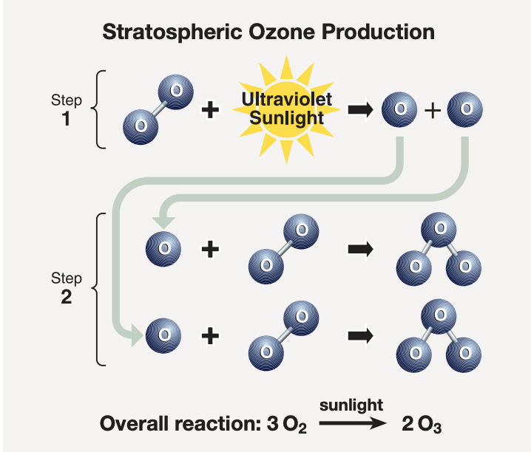
What is the ozone layer and where is it in the atmosphere?
The ozone layer is a part of the Earth’s atmosphere that has relatively high levels of ozone (O3). Ozone is a gas that is naturally present in our atmosphere, and it is found primarily in the part of the atmosphere called the stratosphere, which is about 50 kilometers above Earth. The stratospheric ozone layer acts like a shield in the atmosphere to prevent harmful ultraviolet (UV) radiation from reaching the Earth’s surface. Overexposure to UV can cause a wide range of health problems for humans, such as skin damage (skin cancers and premature aging), eye damage (including cataracts), and suppression of the immune system. UV radiation can also damage sensitive crops, such as soybeans, and reduce crop yields.

Slide 99
2) When was the problem of ozone layer depletion first recognized?
In 1974, scientists discovered that emissions of chlorofluorocarbons (CFCs) were depleting ozone in the stratosphere. CFCs were a common aerosol propellant in spray cans and were also used as refrigerants, solvents, and foam-blowing agents. In the early 1980s, scientists observed a thinning of the ozone layer over Antarctica, and people began describing this phenomenon as an “ozone hole.” Additional research has shown that ozone depletion has occurred on every continent. Chemists Sherwood Rowland and Mario Molina were awarded the Nobel Prize in 1995, for their earlier discovery that human-made CFCs were a major factor in ozone layer depletion.

Slide 100
3) What kinds of human activities lead to depletion of the ozone layer?
Certain industrial processes and consumer products result in the emission of ozone-depleting substances (ODS) to the atmosphere. ODS, such as chlorine and bromine from these emissions, cause depletion of the ozone layer. For example, CFCs, once used in almost all refrigeration and air conditioning systems, eventually reach the stratosphere, where they are broken apart to release ozone-depleting chlorine atoms. Other examples of human-produced ODS are halons used in fire extinguishers which contain bromine atoms. Methyl bromide, an agricultural fumigant, is also a significant source of bromine in the atmosphere.

Slide 101
4) How is ozone measured in the atmosphere?
The amount of ozone in the atmosphere is measured by instruments on the ground and carried aloft on balloons, aircraft, and satellites. Some measurements involve drawing air into an instrument that contains a system for detecting ozone, and other measurements are based on ozone’s absorption of light in the atmosphere.
5) Why has an “ozone hole” appeared over Antarctica when ODS are present throughout the stratosphere? Ozone-depleting gasses are present throughout the stratospheric ozone layer because they are transported great distances by atmospheric air motions. The severe depletion known as the “ozone hole” occurs because of the special weather conditions that exist in Antarctica and nowhere else on the globe.
PSCs, nitric acid, low temperatures, etc…

Slide 102
6) Do changes in the sun and volcanic eruptions affect the ozone layer?
Yes. Factors such as changes in solar radiation, as well as the formation of stratospheric particles after volcanic eruptions, do influence the ozone layer. However, neither factor can fully explain the average decreases observed in total ozone over the last two decades. If there are large volcanic eruptions in the coming decades, ozone depletion will increase in years after the eruption. The largest recent volcanic eruption was Mt. Pinatubo (Chile) in 1991.
7) Does depletion of the ozone layer lead to an increase in UV radiation? Yes. Measurements made using satellite data and other instruments have confirmed that surface UV radiation has increased in regions where ozone depletion is observed. To protect public health from the effects of UV radiation, EPA’s SunWise program promotes sun safety in schools and communities around the country. In addition to applying sunscreen and wearing protective clothing, people can plan their outdoor activities around the UV Index. The UV Index is a tool that provides a daily forecast of the expected risk of overexposure. The Index predicts UV intensity levels on a scale of 1 to 11+, where 1 indicates a low risk of overexposure and 11+ signifies an extreme risk. SunWise and the National Weather Service developed the UV Alert, a real-time tool the public can use to protect themselves from overexposure to the sun. People who subscribe to the UV Alert receive an email notification when the level of UV radiation is especially high in their area.

Slide 103
8) What’s the difference between ground-level ozone and stratospheric ozone? Ozone is a gas that occurs both in the Earth’s upper atmosphere (the stratosphere) and at ground level. Ozone can be “good” or “bad” for people’s health and the environment, depending on its location in the atmosphere. “Good” ozone is produced naturally in the stratosphere and is “good” because it blocks harmful UV radiation from reaching the Earth’s surface where it can harm people and ecosystems.
“Bad” ozone is an air pollutant found at ground level and is “bad” because it is harmful to health and can damage vegetation. Ground-level ozone is a main component of urban smog.

Slide 104
What is the Montreal Protocol and why has it been successful?
During the 1980s, as scientific knowledge of ozone depletion grew, so did the international response to the issue. In 1987, leaders from many countries came together to sign the Montreal Protocol on Substances that Deplete the Ozone Layer. The Montreal Protocol establishes legally binding controls on the national production and consumption of ODS. Today, 191 countries are signatories to the treaty. These countries are committed to taking action to reduce and eliminate ODS to protect the ozone layer, and the U.S. has always been a leader. Production and consumption of all principal ODS by developed and developing countries will be significantly phased out before the middle of the 21st century. The Montreal Protocol has been successful because of scientific accuracy, effective public policy, and market-based, flexible, innovative approaches to ensuring ozone layer protection and developing alternatives. The year 2007 marks the 20th Anniversary of the Montreal Protocol, and is an opportunity to celebrate success and emphasize the commitment to completing the worldwide phase-out.

Slide 105
2) Has the Montreal Protocol been successful in reducing ozone-depleting gases in the atmosphere?
Yes. As a result of the Montreal Protocol, the total abundance of ozone-depleting gases in the atmosphere has begun to decrease in recent years. If all countries that have signed the Protocol maintain their commitments, the decrease of ODS in the atmosphere will continue through the 21st century.

Slide 106
3) What has EPA done about ozone layer depletion?
As part of the United States’ commitment to implementing the Montreal Protocol, the U.S. Congress amended the Clean Air Act (CAA) in 1990 and 1998, adding provisions under Title VI for the protection of the ozone layer. Most importantly, the Act required the gradual end to the production of ozone-depleting chemicals. Under the CAA, EPA has created several regulatory programs to address numerous issues, including: • Ending the production of ODS; • Ensuring that refrigerants and fire extinguishing agents are recycled properly; • Identifying safe and effective alternatives through the Significant New Alternatives Policy (SNAP) program; • Banning the release of ozone-depleting refrigerants during the service, maintenance, and disposal of air conditioners and other refrigeration equipment; • Requiring that manufacturers label the products either containing or made with the most harmful ODS; and • Creating exemptions to the phase-out in sectors where the transition to alternatives is ongoing.
With input from industry, environmental groups, other U.S. government agencies, and the public, EPA has published a range of regulations for the protection of the ozone layer. Because of their high ozone-depleting potential, chemicals such as CFCs, methyl chloroform, and halons were targeted for phase-out first, and EPA is preparing to phase out the remaining substances. EPA continues to develop additional regulations under its ozone protection program for the continued protection of the environment and public health.

Slide 107
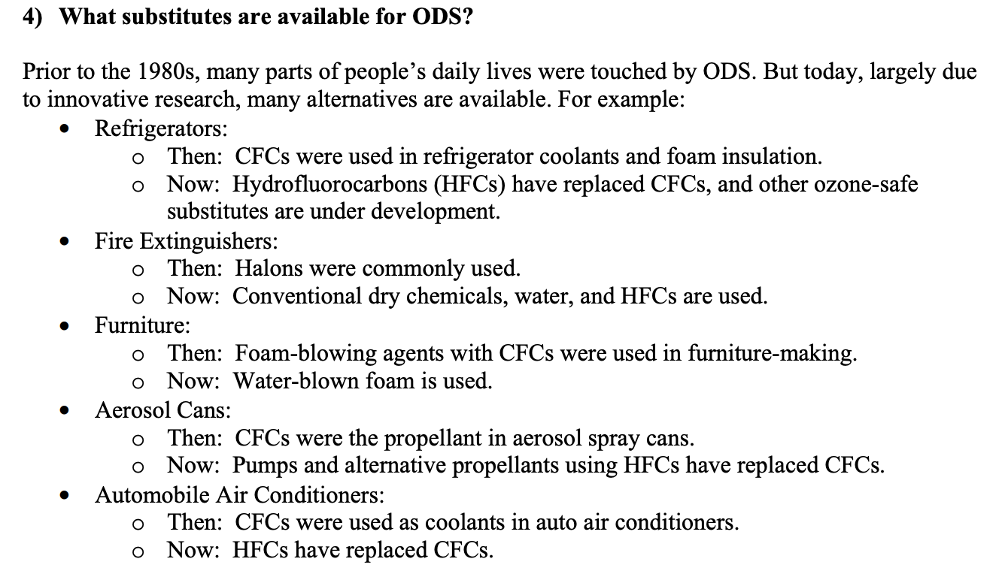

Slide 108
The foundation for EPA’s regulatory efforts to adopt more ozone-friendly alternatives is the Significant New Alternatives Policy (SNAP) program. The SNAP program was launched in 1994 to ensure a smooth transition to practical, safe, and economically feasible alternatives across multiple industrial, consumer, and military sectors. SNAP provides a framework for EPA to evaluate the health and environmental impacts of alternatives to ODS. Based on these evaluations, EPA determines which substitutes are acceptable, which are acceptable with conditions, and which are unacceptable. Through the SNAP program, EPA has approved more than 300 alternatives for more than 60 industrial, commercial, and consumer end uses.

Slide 109
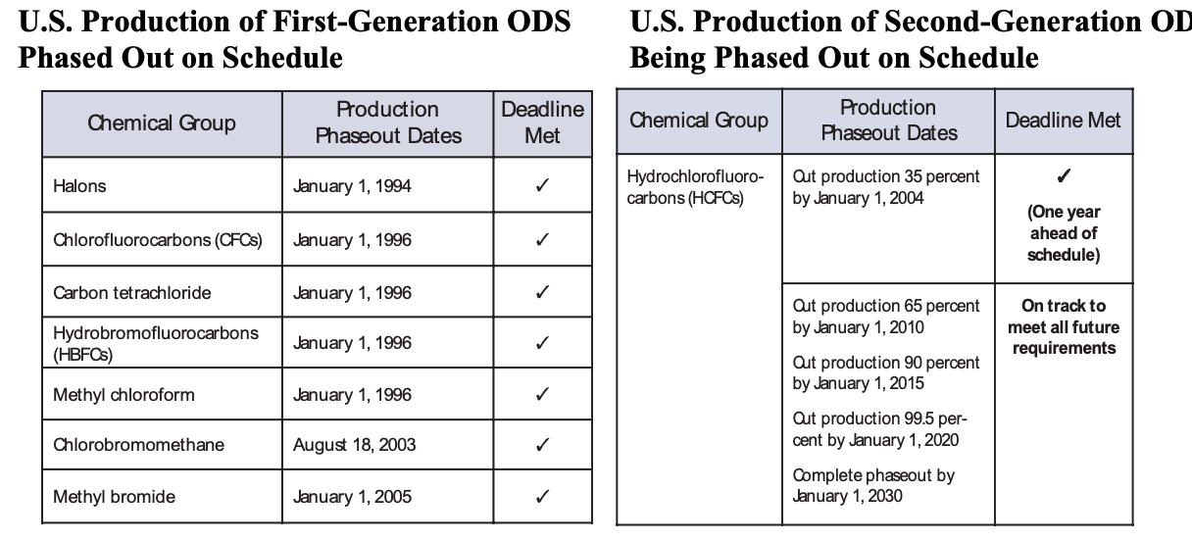

Slide 110
Questions about the Future of Ozone Protection 1) Does ozone layer depletion cause climate change?
Scientists continue to study the possible relationships between ozone layer depletion and climate change. Since ODS and their substitutes contribute to climate change, phasing out ODS directly benefits the Earth’s climate in two ways. Since most ODS are also greenhouse gases, phasing out these substances reduces greenhouse gas emissions. Second, when ODS substitutes are introduced, the equipment in which they are used is upgraded, which means they are more efficient and less leaky.
2) When is the ozone layer going to recover?
The ozone layer has not grown thinner since 1998 over most of the world, and it appears to be recovering because of reduced emissions of ODS. Some breakdown can be expected to continue due to CFCs used by nations which have not banned them, and due to gases which are already in the stratosphere. Certain CFCs have very long atmospheric lifetimes, ranging from 50 to over 100 years, so final recovery of the ozone layer is expected to require several lifetimes. Scientists predict that the ozone layer will return to pre-1980 levels sometime between 2060 and 2075. Sustained recovery of the ozone layer will require a worldwide phase-out of all ODS by both developed and developing countries.

Slide 111
3) What about skin cancer rates increasing?
Over the last 30 years, the skin cancer incidence has gone from 1 in 1500 to 1 in 75. Currently melanoma, the most fatal form of skin cancer, is the number one killer of young women ages 25-29. Researchers believe that overexposure to UV is one factor contributing to an increase in melanoma, in addition to other factors. However, by the year 2165, actions to protect and restore the ozone layer will save an estimated 6.3 million U.S. lives that would have otherwise been lost to skin cancer.

Slide 112
4) What does EPA plan to do next? Since healing the ozone layer is expected to take many years, EPA plans to continue to expedite the recovery of the ozone layer. Among EPA’s near-term plans: • Complete the ODS phase-out; • Continue educating the public, especially children, on how to protect themselves from UV exposure through the SunWise program; • Continue to implement innovative, flexible regulatory approaches; • Continue to foster domestic and international partnerships to protect the ozone layer; and • Encourage the development of products, technologies, and initiatives that reap cobenefits in climate change and energy efficiency. On March 14, 2007, EPA, with the Department of State and the National Oceanic and Atmospheric Administration, put forth a proposal to adjust the Montreal Protocol and accelerate the phase-out of HCFCs. Several other countries also submitted proposals. The U.S. proposal includes four elements that can be considered individually or as a package: 1) Accelerating the phase-out date of HCFCs by 10 years; 2) Adding interim reduction steps; 3) Setting an earlier baseline; and 4) Phasing out the most damaging HCFCs to the ozone layer as a first priority. These proposals further U.S. efforts to address ozone layer protection, cleaner air, and climate change by calling on the global community to act more quickly in phasing out HCFCs.

Slide 113
5) Many of the alternatives to ODS have high global-warming potential (GWP). Why is the climate system being damaged this way? The Intergovernmental Panel on Climate Change (IPCC) has noted that the global decline in emissions of ODS has substantial climate benefits. The combined emissions of CFCs, HCFCs, and HFCs have fallen from about 33 percent of the annual carbon dioxide emissions from fossil fuel combustion around 1990 to about 10 percent around 2000. However, EPA will continue to research and evaluate ozone-friendly alternatives that have low GWP. 6) The U.S. is still requesting exemptions for CFCs in metered-dose inhalers (MDIs) and methyl bromide. Why haven’t these been phased out yet? Exemptions are permitted under both the Montreal Protocol and the CAA for sectors where ODS consumption is necessary for public health or for sectors where there are no technically or economically feasible alternatives.
In the MDI sector, the transition to ozone-friendly alternatives is well underway and the U.S. has only proposed 28 metric tonnes for essential use exemptions in 2008.

Slide 114
8) If 2006 was the largest hole on record, how is the ozone layer recovering? The ozone “hole” varies from year to year and depends on atmospheric concentrations and temperatures. The ozone “layer,” however, has not grown thinner since 1998 over most of the world, and appears to be recovering because of reduced emissions of ODS. Antarctic ozone is projected to return to pre-1980 levels between 2060 and 2075.

